Slide 1
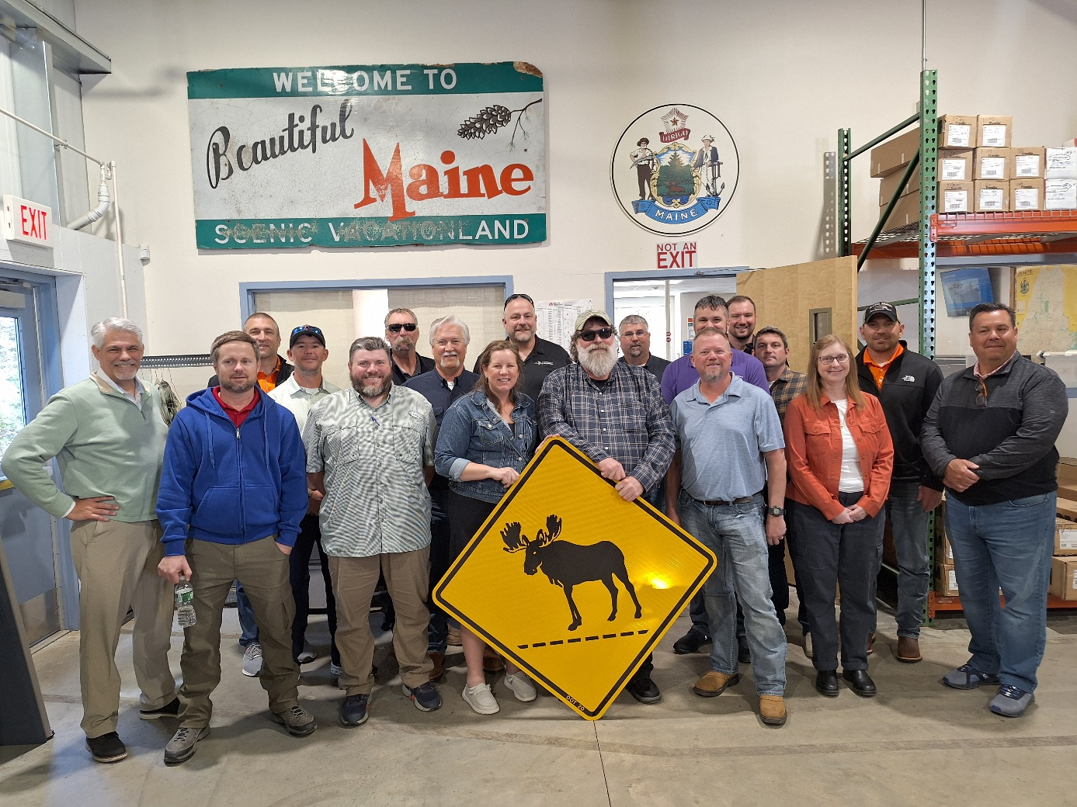
April/May 2025 Peer Exchange
No Boundaries held a peer exchange from April 29 – May 1, 2025
  In-person meeting in Portland, hosted by MaineDOT
Meeting information at maintainroads.org/may-2025-portland-me/
  Detailed documentation available for members with login

Slide 2

Maine DOT Welcome and Overview
Joyce Taylor, Chief Engineer, MaineDOT
Overview of MaineDOT’s current maintenance challenges and priorities.
  Asset resiliency
  Keeping Maine’s inventory of ‘fair’ bridges in fair condition
  Maintenance prioritization
  Implementing innovations

Slide 3

Member Presentation: MaineDOT
Jim Saban, MaineDOT
Overview of MaineDOT’s organizational structure, strategic focus, and asset maintenance responsibilities
  1,800 employees
  $675 million annual budget
  Nearly 18,000 lane miles of highway
  2,974 bridges and spans
  400 plow trucks
  7 ferry boats and terminals

Slide 4

Round Table 1. Innovations Show and Tell
Selected Highlights
Innovation Program (South Carolina)
  Last year was first year of the program and only included maintenance innovations. This year will be open to anyone across the agency.
Tethered Drone with Lights (Maine) ►
  Blue Vigil drone improves nighttime visibility and safety in work zones with lower piloting requirements.
Comprehensive Safety Review for Repairing High-Tension Cable Barrier (Minnesota)
  Identified safest repair method for each task, scored probability and severity before and after risk mitigation.

Slide 5
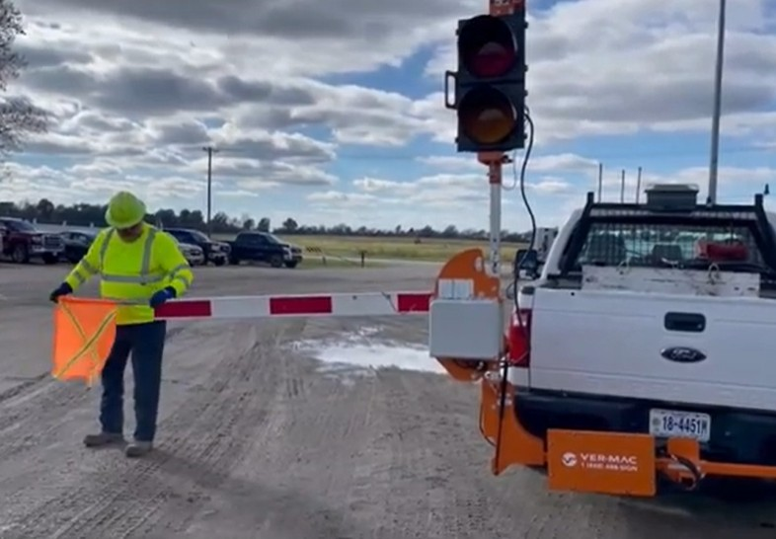
Round Table 1. Innovations Show and Tell continued
Selected Highlights
Dyna-Wipes (Indiana)
  Disposable cleaning cloths that can clean tools without causing damage, and graffiti from signs without affecting reflectivity.
Electronic Driver Vehicle Inspection Report (DVIR) System (Michigan)
  Inspection reporting allows voice recognition for more write-ups.
Hitch-Mounted Flagger (Missouri) ►
  With a water truck up front, lanes don’t need to be closed and it’s much safer.

Slide 6
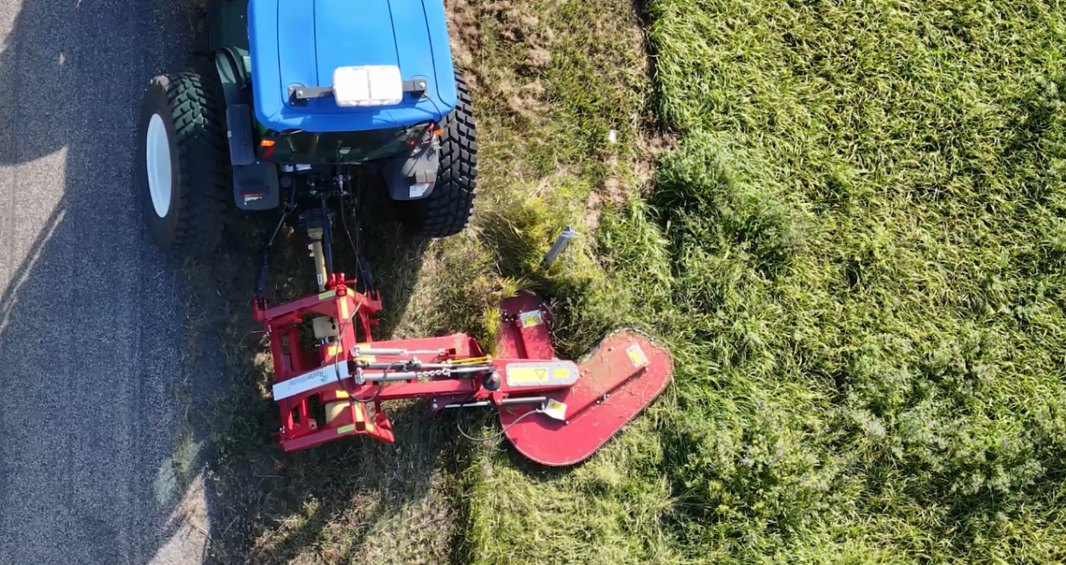
Challenges and Issues - Adapting to Federal Changes
How do funding changes and delays at the federal level impact states’ access to materials and work with contractors and subcontractors?
  States reported that prices of materials like aggregates, steel and aluminum have risen significantly.
  Tariffs may affect the affordability and availability of tungsten and carbides.
  Buy America programs may make it harder to find some products and materials like striping paints, which can contain beads made in China.
  Many states also reported that their maintenance programs have otherwise yet to be affected by changes at the federal level.

Slide 7
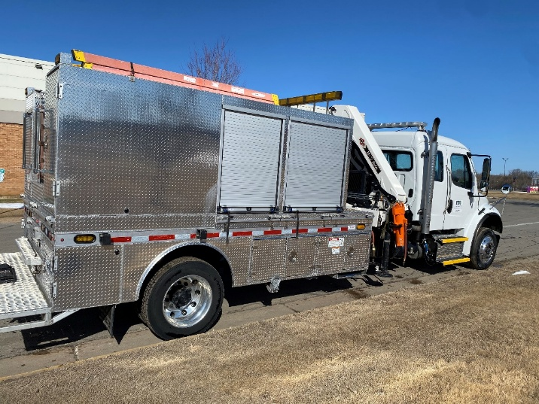
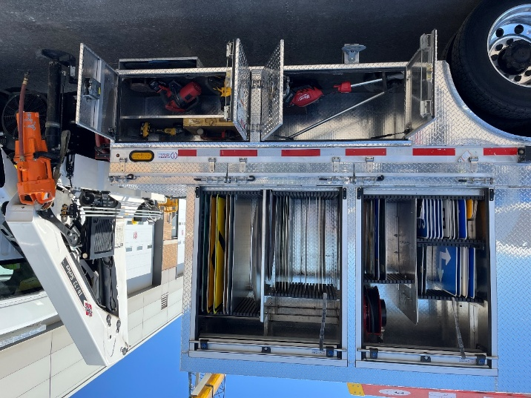
Round Table 2: Equipment Used for Sign Crew Trucks
Selected Highlights
What types of vehicles do states’ sign crews use?
  2023 Freightliner M2 106, GVWR 33,580 lbs. (Minnesota) ►
  Crane truck with wireless controls (“Big Digger”), frame sign trailer, knuckle boom truck (“Little Digger”), personnel hoist, cargo truck. (California)
  Class 8 body with 70-foot reach and 6,200 lb. capacity, GVWR trailers. (Virginia)
  Crane trucks (Elliot and Sterling), service trucks (Dodge Ram 5500s, 8000 lb. capacity) (Utah)
  Center Mounted Digger Derrick w/ 15k lbs. Capacity Winch and 45’ Reach. (Illinois)

Slide 8
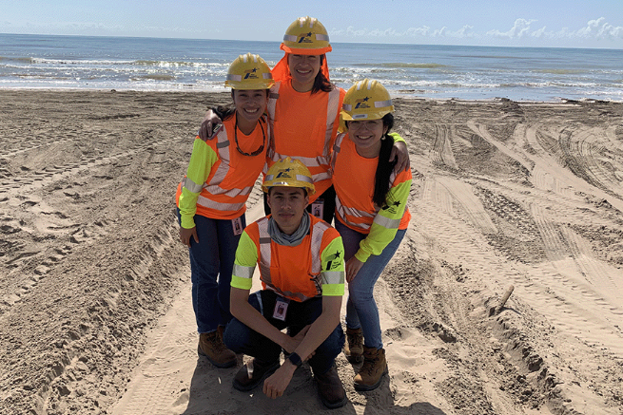
Presentation: Texas DOT’s Internship Program
Kent Clements, Texas DOT
Texas DOT offers internships for all kinds of jobs.
  Each of the DOT’s 25 districts can have 10 interns plus engineers, for a total of 400 interns across the agency per year.
  Interns must be 16 or older.
  Program works especially well for sign technicians and inspections.

Slide 9

Presentation: Connecticut DOT’s Apprentice Program
Bill Gombotz, Connecticut DOT
Connecticut DOT began its apprenticeship program in September 2024.
  Received 414 qualified applicants >> 96 applicants interviewed >> 20 positions offered.
  Pre-employment requirements
    Physical and drug test
    Reference and background checks
    Confirmation of FMSCA and CDL Permit statuses

Slide 10
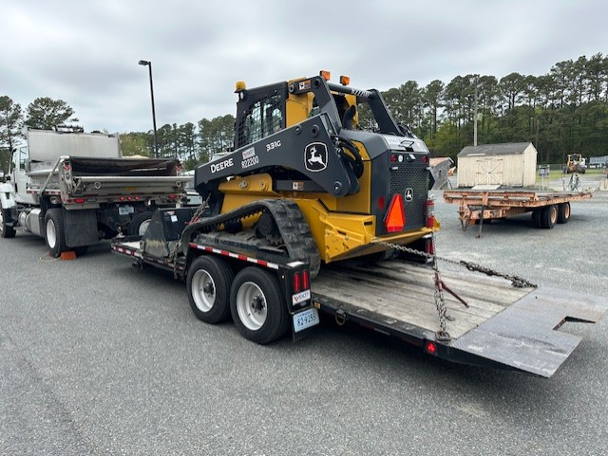
Round Table 3. Hauling Skid Steers
Selected Highlights
What is your state using for transporting skid steers?
  ND tows Bobcat T76 skid steers with tandem axle plow trucks. Maintenance pays a high hourly rate to the state fleet division for plow trucks and are looking for a more cost-effective solution to move equipment from site to site for maintenance tasks. (North Dakota)
  Many different trucks for transporting skid steers, from F350a-F650a pickup trucks, dump trucks, and occasionally a semi-truck (Illinois).
  Single-axle dump truck with a 10-ton trailer. (Maryland)
  Class 5-6 trucks with towing capacity of 18,500lbs, Class 7-8 trucks outfitted with a pintle hook and rated for 30 tons, and trailers ordered with skid steers. (Virginia) ►

Slide 11

Presentation: MaineDOT’s Innovation Program
Dawn Bickford and Jeffrey Pulver, MaineDOT
MaineDOT’s Innovation Council is made up of a variety of decision-makers and experts.
The group meets quarterly and has a budget of $80k per year to implement innovations.
Innovations can be submitted year-round.
Agency is planning a showcase for 2026 to highlight accomplishments.

Slide 12
Business and Planning Meeting
Commitments and transfers; budget and spending
Update on Phase IV commitments and progress
Discussion of operating procedures
Future peer exchanges

Slide 13
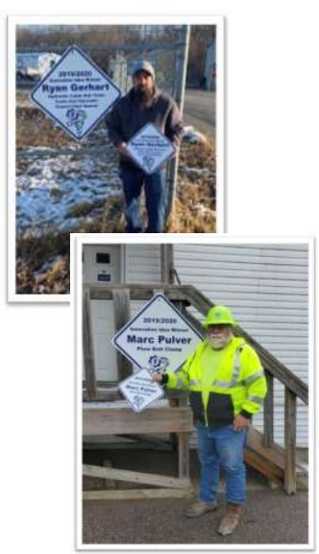
Member Presentation: Indiana DOT
Todd May, Indiana DOT
Indiana DOT has made a variety of changes to improve its culture.
  The agency conducts an annual employee survey.
  It has also developed an Innovation Program to encourage and reward innovative ideas from staff.
    The program has received more than 700 submissions over the last several years.
    Winners receive $500 and a $500 tool/department allowance, a sign, an oversized check, and a hardhat sticker.
  Since making the changes, staff turnover at Iowa DOT is down 50%.

Slide 14
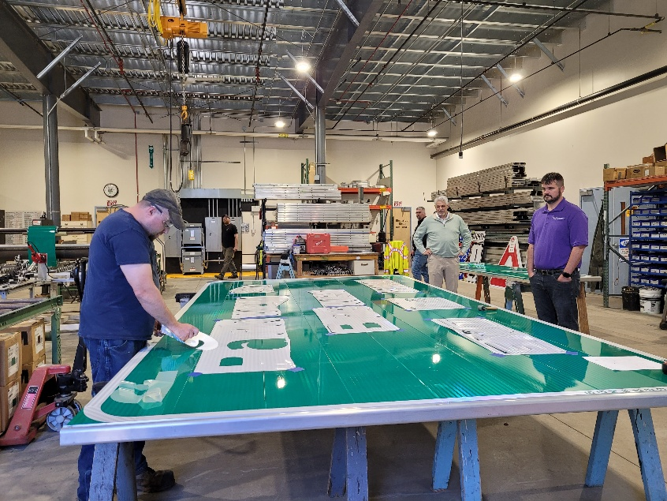
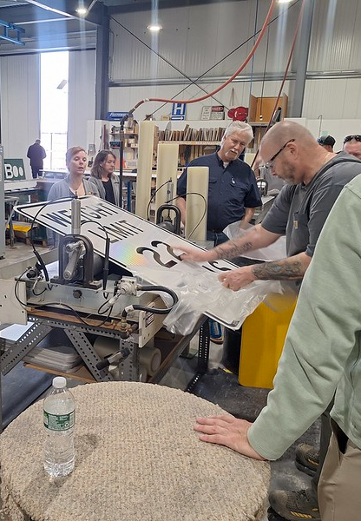
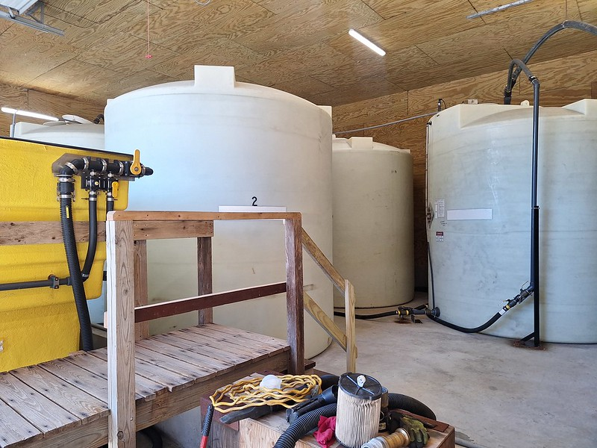
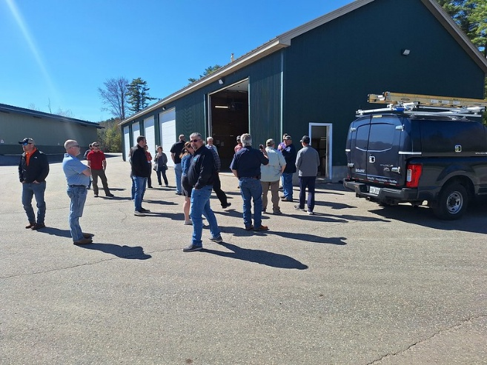
Technical Site Visits
MaineDOT Sign Shop
  Houses specialized equipment for printing on vinyl
MaineDOT Maintenance Shed
  Indoor salt brine tanks and equipment
  1 full-time maintenance technician
More pictures available on Flickr

Slide 15
FHWA Strategic Workforce Development (SWD) Program
Chrissy Currier, SWD Program Manager, FHWA
Overview of FHWA’s efforts to support states’ workforce development programs and activities
  More at https://www.fhwa.dot.gov/innovativeprograms/centers/workforce_dev/

Slide 16
Presentation: Ohio’s Fleet Optimization Group
Mark Bressler, Ohio DOT
Ohio DOT evaluated its construction fleet
  Goal is to get more usage from existing equipment
  Switching from pickups to SUVs, and putting inspectors in smaller vehicles can save more than $7M
  Identified a number of best practices, including
    Regional mowing
    Plant growth regulator program
    Buy skid steer attachments, when possible, instead of stand-alone equipment

Slide 17
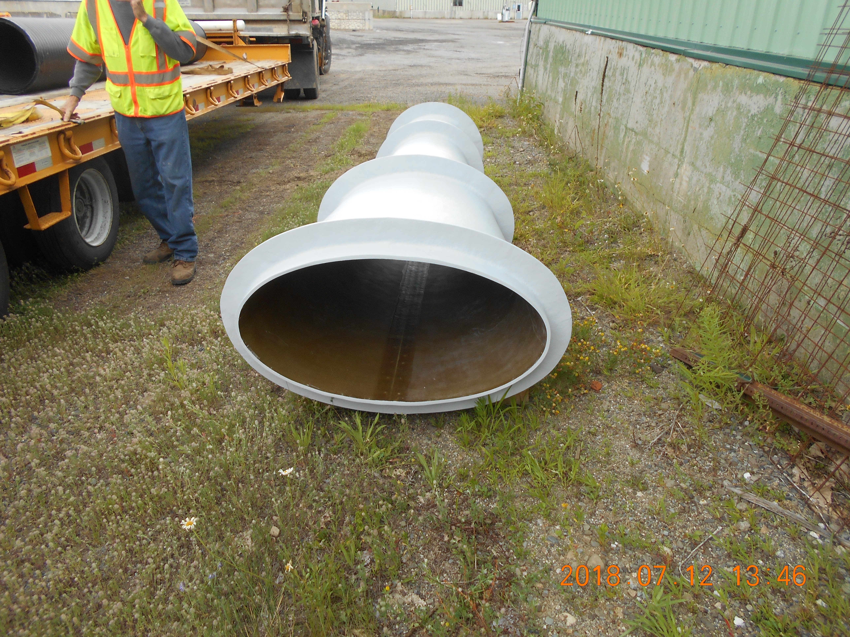
Presentation: Flared Outlet Diffusers
Alex Mann, Culvert Diffuser Systems LLC
MaineDOT research project developed the culvert diffuser.
It’s a simple design that can double the outlet cross-sectional area and increase culvert capacity by about 40%.
More at MaineDOT Research Technical Report 14-17: Outlet Diffusers to Increase Culvert Capacity https://rosap.ntl.bts.gov/view/dot/31351

Slide 18
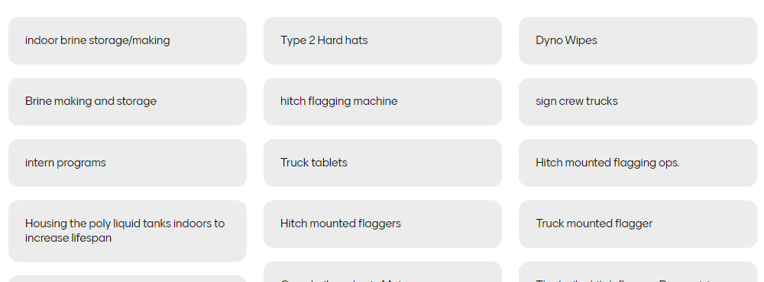
Takeaways
“Aha moments,” big takeaways and great ideas to borrow or learn more about came from all portions of the meeting
  Presentations
  Roundtable discussions and
  innovations highlights
  Site visits and demonstrations
  Informal and
  offline networking
What are your takeaways from this meeting?
Next Peer Exchange
Spring 2026

