Slide 1
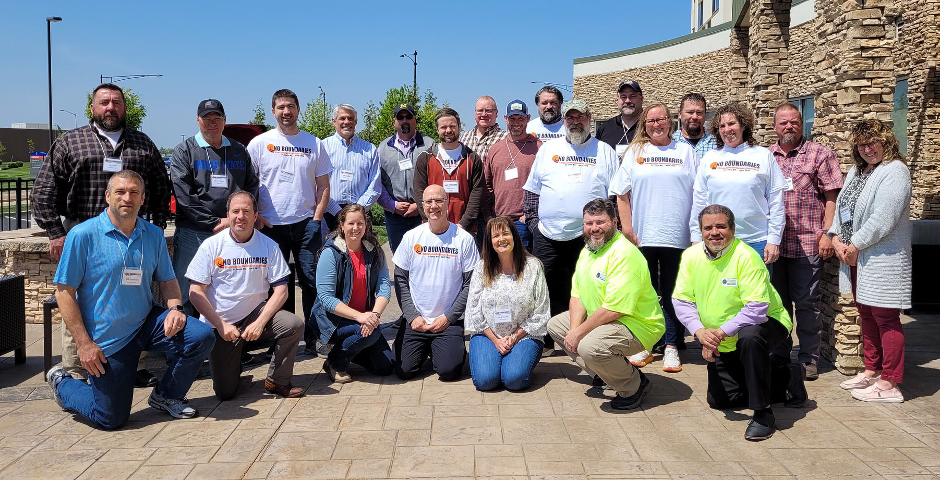
April 2023 Peer Exchange
No Boundaries held its first peer exchange of 2023 on April 25 and 26
Hosted by Missouri DOT
In-person meeting in St Peters and State Innovations Showcase in Columbia
Meeting information at maintainroads.org/april-2023-st-louis/
Detailed documentation available for members with login

Slide 2
Missouri DOT Innovations Showcase, Columbia MO
No Boundaries members gained first-hand knowledge of the innovations and takeaways for similar programs in their home states
The top MoDOT innovations were recognized during an awards ceremony by MoDOT Director Patrick McKenna
Pictures available on Flickr
Members traveled to Columbia, MO to attend MoDOT’s Innovations Showcase
The event allowed MoDOT employees to discuss and demonstrate their own new innovative products, materials, processes, tools, and equipment

Slide 3
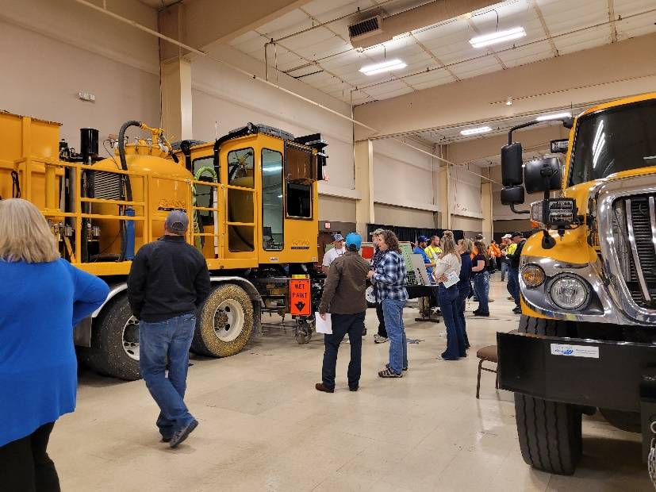
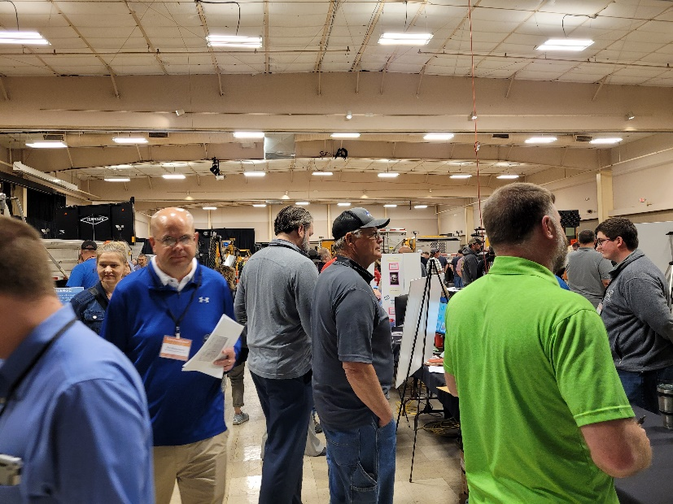
Missouri DOT Innovations Showcase – Columbia, MO
View all of the MoDOT innovations at www.modot.org/innovations-showcase-homepage

Slide 4
Missouri DOT Welcome and Overview
Missouri DOT Welcome – Jimmy Shannon, Assistant District Maintenance Engineer, Missouri DOT
Debrief on Missouri DOT Innovations Showcase
Incentives can encourage staff to submit innovations, and may include financial prizes or other benefits
Staff are proud to share their own innovations
A successful program requires a top-down approach

Slide 5
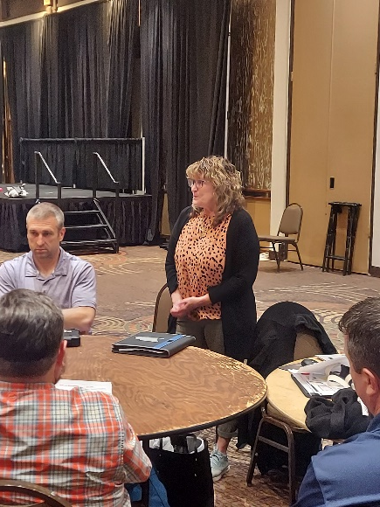
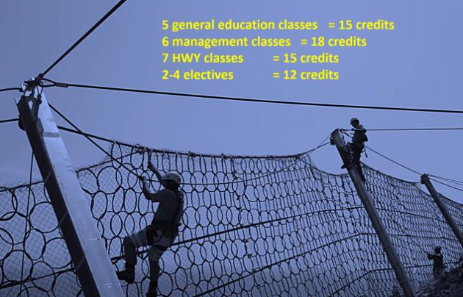
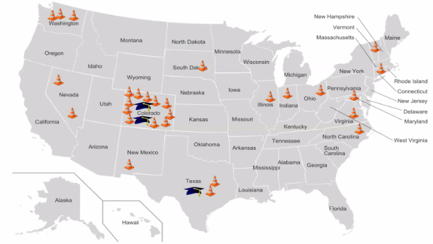
Presentation: Front Range Community College
Susan Baillargeon, Program Director
Update on Associates Degree Program
Enrollment and progress since previous No Boundaries meeting
Coursework and requirements
High School Internship Program
Piloted spring 2022
OSHA 10-hour certification
Highway 101 Intro to Highway Maintenance course
Internship
Benefits to agencies and to students

Slide 6
TAC Poll Results Highlights
Industry training for guardrail installation – Submitted by TxDOT
TAC members shared status of training programs and details of processes/procedures
Environmentally friendly truck washes (soaps, degreasers, salt neutralizing agents) – Submitted by NYS DOT
Results show that most No Boundaries members are not aware of any issues with 1,4-Dioxane – an ingredient listed on common truck washes

Slide 7
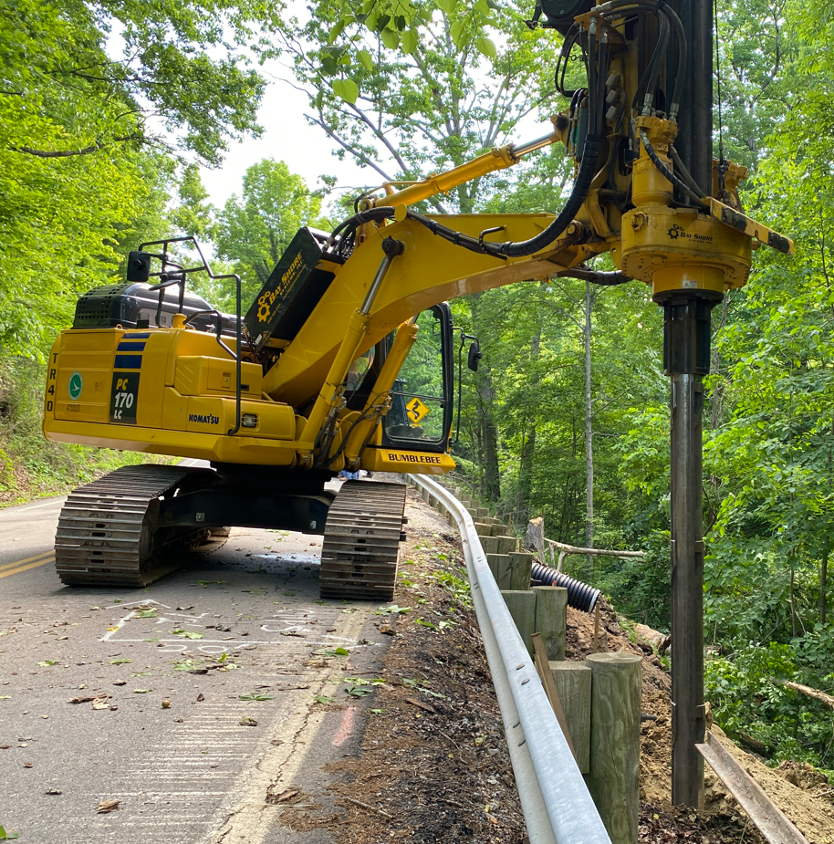
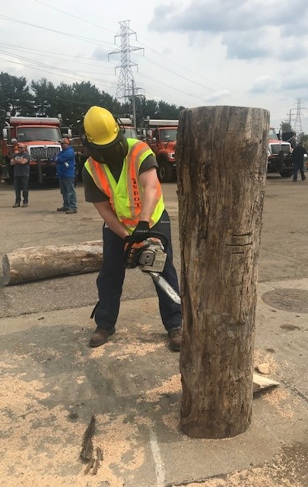
Round Table 1. Innovations Show and Tell Selected Highlights
LoDril Operation for Drilled Shaft Walls (Ohio) ►
Quickly responds to small slides to get roads open after heavy rains
Plow Wing Early Collision Warning System (Colorado)
Blind spot detector with audible alarm
Chainsaw Safety and Tree Cutting Program (Michigan) ►
Chainsaw safety and cutting techniques

Slide 8
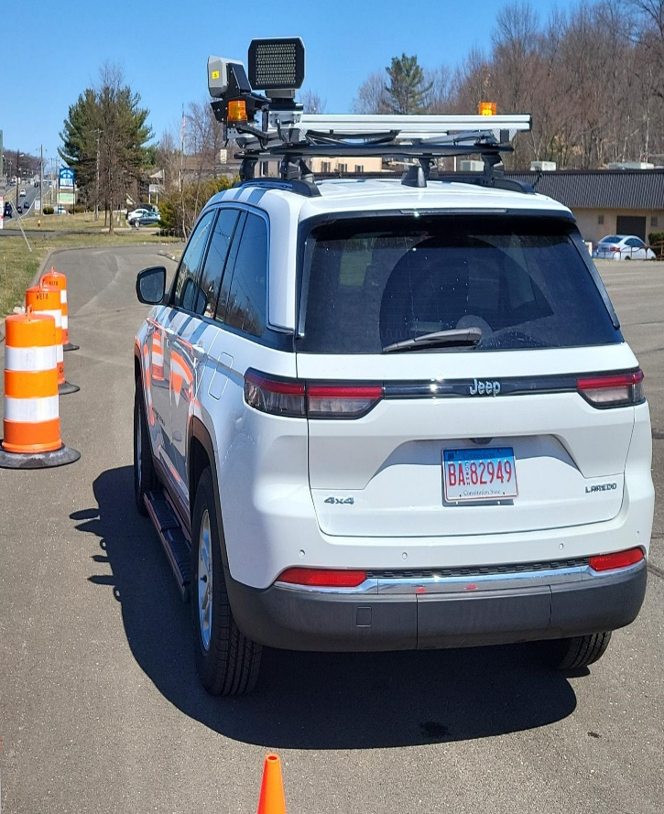
Round Table 1. Innovations Show and Tell continued
Work Zone Speed Safety Camera Pilot Program (Connecticut) ►
Vehicles parked in work zones capture speed and license info for ticketing
Halo SL Lights (California) ►
Hands-free task lighting
D03 Swivel Beacon Lights (Louisiana)
Allows dump bed beacon lights to rotate and remain level when bed is raised

Slide 9
Presentation: ODOT Maintenance Savings via Fuel Tax
Richard Winning, Executive Financial Advisor/Innovations Coordinator
“One Red Lion” campaign is committed to saving $100 million over 4 years in operational improvements and efficiencies
More than 2,000 ideas shared and $113.3 million saved so far from implemented ideas

Slide 10
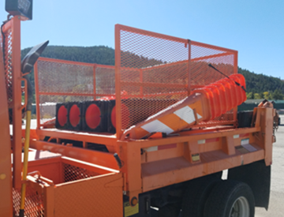
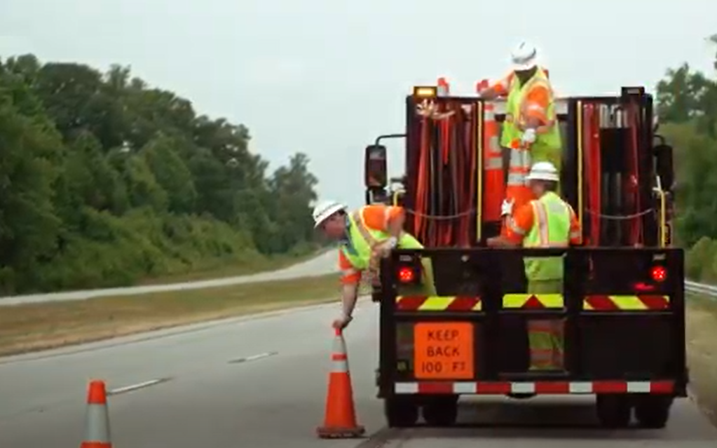
Round Table 2. Deploying Cones or Barrels Selected Highlights
How are standardized traffic control trucks used?
Cone Loading Basket for Trucks (Colorado) ►
Barrel placement work is outsourced to private traffic control company for liability reasons (Utah)
Cones deployed from side, have bucket seats with conveyor belts (California)
Image courtesy of Virginia DOT

Slide 11
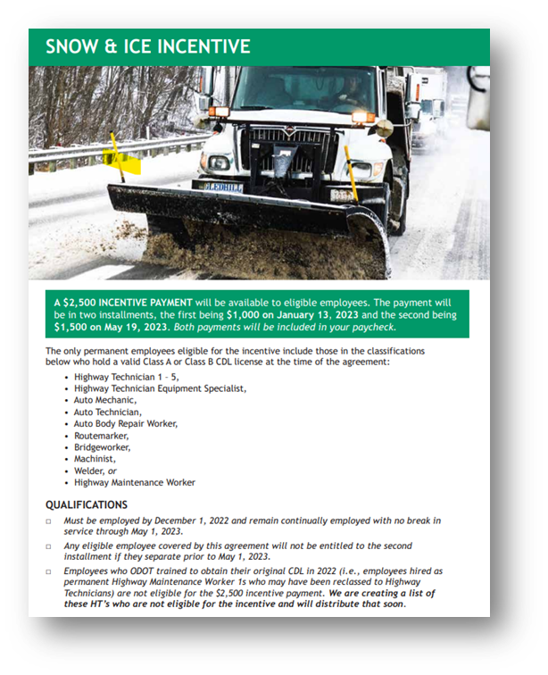
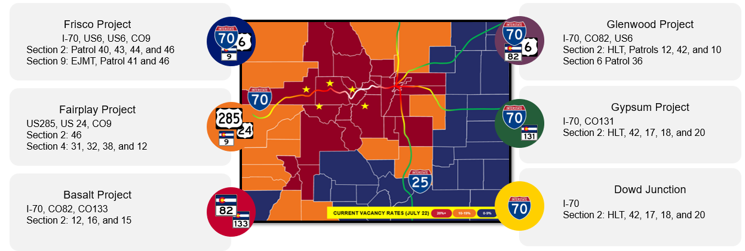
Round Table 3. Follow up solutions for staffing shortages Selected Highlights
Solutions to deal with staffing shortages
$2,500 incentive pay to have staff stay through May 1, 2023 (Ohio) ►
Hire temporary employees (South Carolina)
Strategies to attract and retain workers
Create housing for Maintainers (Colorado) ►
Workforce Commissions and second chance fairs to reach underserved communities (Louisiana)

Slide 12
Business and Planning Meeting
Vote on Steering Committee Chair (Todd May, Indiana DOT) and Vice Chair (Steven Sibley, Louisiana DOT). New Steering Committee member (Ken Relation, New York State, DOT)
Timeline for next phase of pooled fund, new lead state search
New Lead State – Indiana
Need to develop draft Pooled Fund solicitation
Commitments and transfers; budget and spending
Marketing
AASHTO Committee on Maintenance July meeting potential presentation
Pooled fund flyer and/or trading cards, outreach, marketing plan, and website updates
Synthesis Research
Proposed equipment management/procurement practices
Other New Activities for Year 3, Year 4

Slide 13
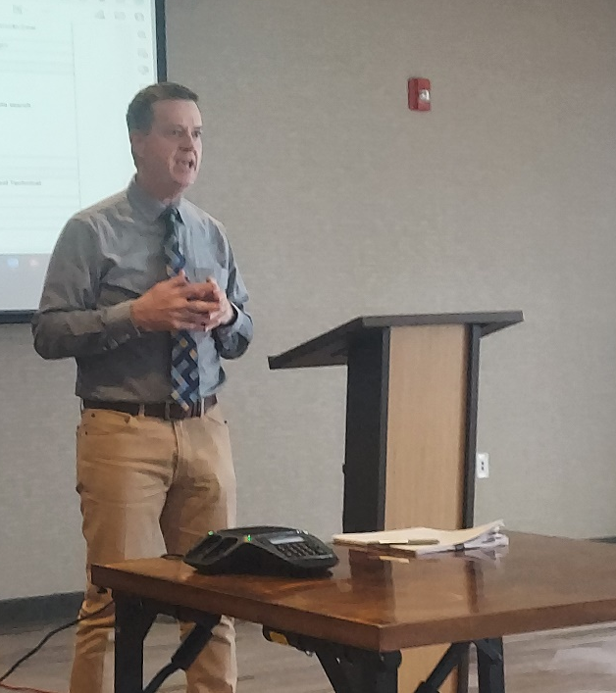
Presentation: National Local & Tribal Technical Assistance Program
Heath Pickerill, Vice President
Created New Safety Circuit Rider position that shares innovations with local agencies in Missouri
Currently developing a local innovations competition
Partners with Missouri cities and counties and APWA on various innovations and training
Promotes training and outreach through various conferences

Slide 14
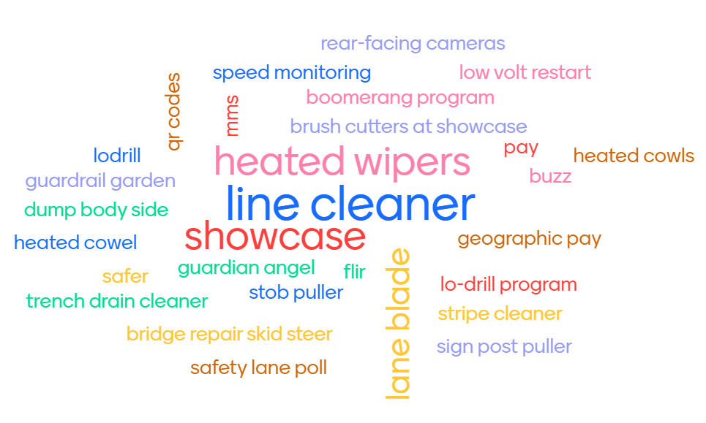
Takeaways
Name an innovation you saw that you'd like to ‘steal’ for your own agency...
“Aha moments,” big takeaways and great ideas to borrow or learn more about came from all portions of the meeting
Presentations
Roundtable discussions and innovations highlights
Technical site visit
Informal and offline networking
Next Meeting
NY State – Fall 2023

