Slide 1

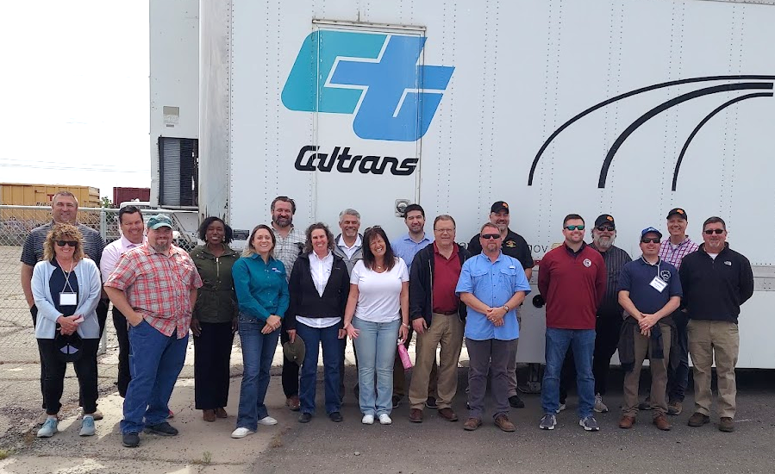
May 2022 Peer Exchange
No Boundaries held its first peer exchange of 2022 from May 3-5
  In-person meeting in Sacramento
  Simultaneous virtual option for remote participants
Meeting information at maintainroads.org/may-2022-sacramento-ca/
  Detailed documentation available for members with login

Slide 2
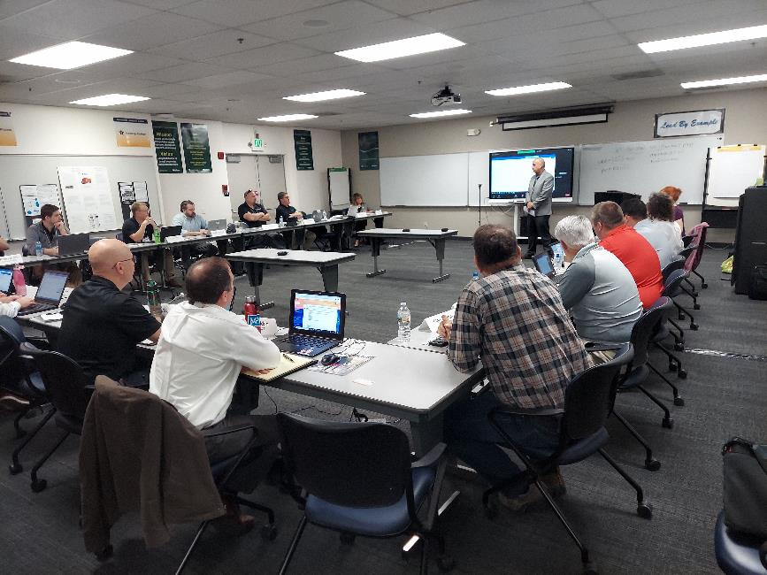
Caltrans Welcome and Overview
Sergio Aceves, Division Chief, Caltrans Maintenance
Maintenance priorities on safety
Strategic planning
Caltrans maintenance innovations and implementation of new technology
Q&A for different maintenance issues (wrong-way driving, encampments)
  Contracting details
  Budget allocation
  Roles, responsibilities, liabilities for different state agencies

Slide 3
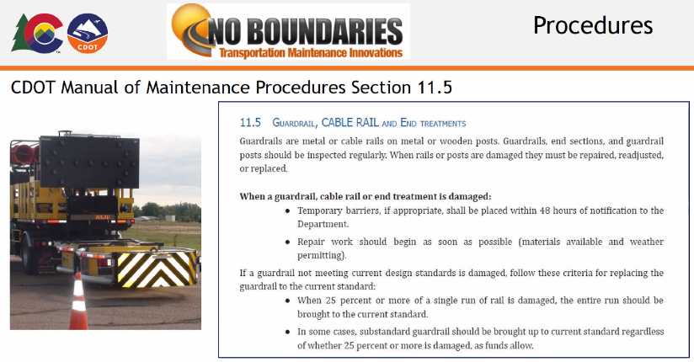
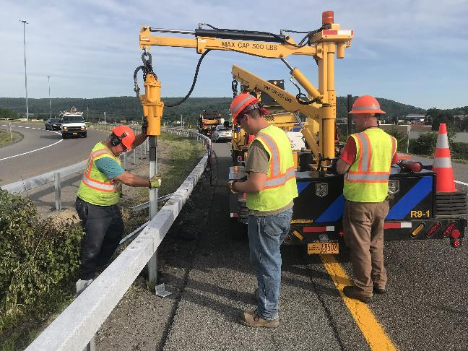
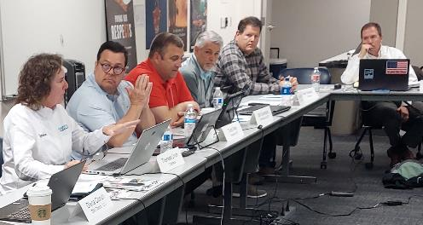
Round Table 1. Guard Rail Best Practices and Issues
Requirements and official procedures
Issues
  Types of rail
  Delivery time – highly variable
  Funding and allocation
  Training
  Finding parts for older-type rail
Innovations
  Benefits of sole sourcing
  Guardrail crash sensors
  Inventory app
  New equipment to conduct repairs/replacement

Slide 4
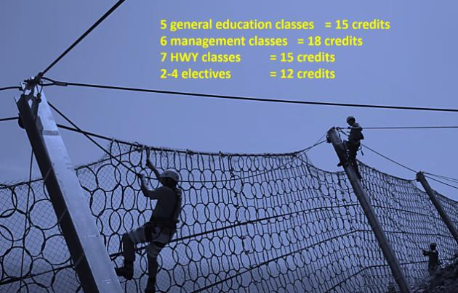
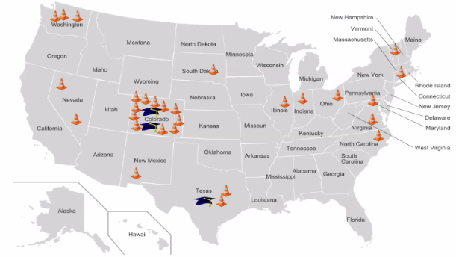

Presentation: Front Range Community College
Susan Baillargeon
Update on Associates Degree Program
  Enrollment and progress since previous No Boundaries meeting
  Coursework and requirements
High School Internship Program
  Piloted spring 2022
  Components
    OSHA 10-hour certification
    Highway 101 Intro to Highway Maintenance course
    Internship
  Benefits to agencies and to students

Slide 5
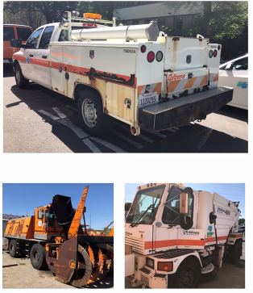
Presentation: Caltrans Plans for Zero Emission Vehicles (ZEVs)
Ed Hardiman and Barby Valentine
Need for emission reduction
California executive orders and California Air Resources Board ZEV regulations
  Advanced clean truck, clean fleet, commercial harbor craft, emission forklifts
“Breathe Clean CA” funding
Fleet greening in California
  Charging installation progress and issues

Slide 6
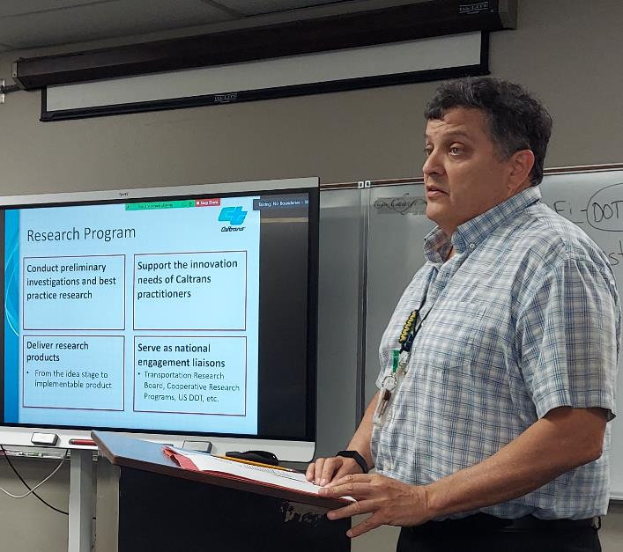
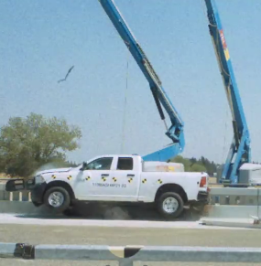
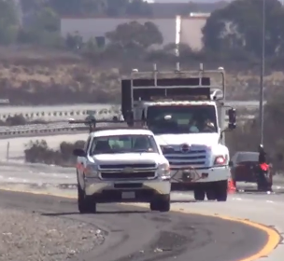
Presentation: Caltrans Safety Innovations
Joe Horton, Division of Research, Innovation and System Information
Safety research
  MASH testing for bridge rails and barriers
  Automated truck mounted attenuators
  Work zone alarms
  Orange stripe in construction zone
  Work zone ITS: HAAS alert, iCone

Slide 7
Round Table 2. Impact of New Commercial Driver’s License Requirements
Review of survey in progress on this topic, part of a No Boundaries synthesis on workforce shortages
  8 states responding
    Impacts so far of new federal CDL rules
    Agency changes being made to meet requirements
  Survey to close later in May
  Addition of survey question on bonuses for CDLs (new-hires, existing agency employees) and associated noncompete agreements

Slide 8

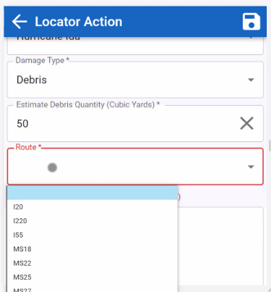
Round Table 3. Innovation Show & Tell
Selected Highlights
Digitization of all VHS- and DVD-based training videos and making them available on an in-house server (Michigan)
  Follow-up discussion on creating and publishing videos
Implementation of innovation program (Maine)
Use of mastic for pavement repairs and patching a “game-changer” for maintenance (New York)
  More expensive than cold patch, but stays where you put it. Also less exposure for workers
STORRM app to record extreme weather events (Swift Transportation Operation Response and Recovery Monitoring). Serves state and FEMA needs (Louisiana) ►

Slide 9
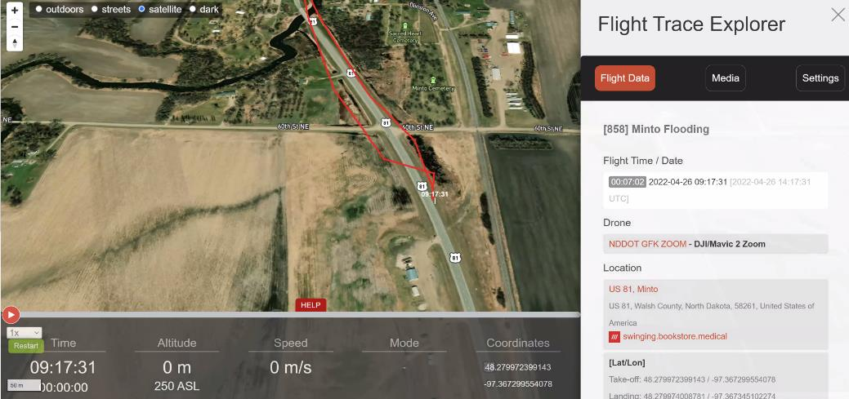
Innovation Show & Tell continued
ESRI-based app for tracking and scheduling deer and bear carcass removal (Wisconsin)
Application for drone monitoring
and documentation (logs,
operations records, checklists,
manuals) (North Dakota) ►
“Amazon Store” for ordering
innovations from
Innovation Showcases (Missouri)

Slide 10
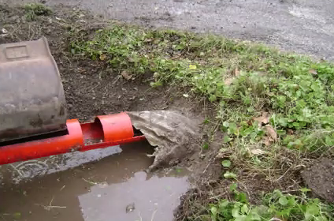
Innovation Show & Tell continued
Full-depth reclamation with in-house resources for rural highway (Texas)
Online maintenance work request form for use by the public (South Carolina)
Corrugated culvert straightener (Louisiana) ►
Research into screening median drainage (Ohio)

Slide 11
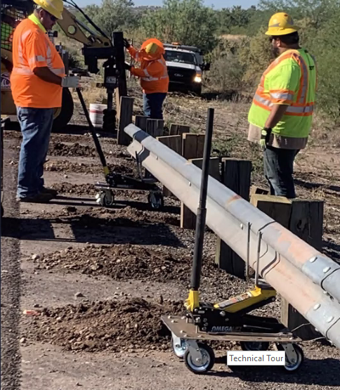
Innovation Show & Tell continued
Arizona’s “Guardrail Crab” for easy movement and placement of guardrail (Colorado) ►
Set up community of practices within the agency with push alerts when ideas are submitted (Virginia)
Water-activated pavement patch (Connecticut)
  Working well with staff training and guidance
Tailgate prop fabricated with used signposts; employee recognition (Indiana)
“Innovation Station” idea submission program (California)

Slide 12
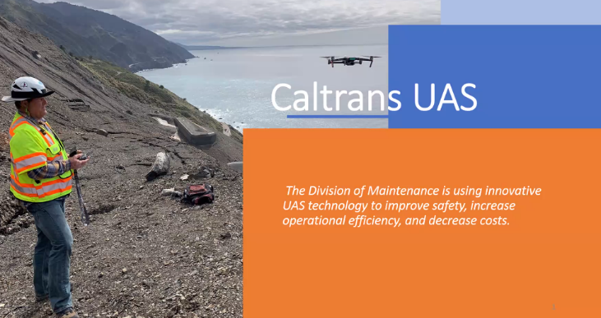
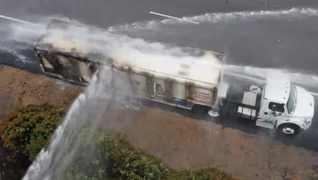
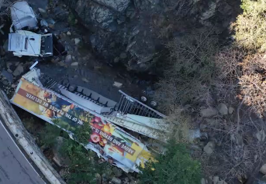
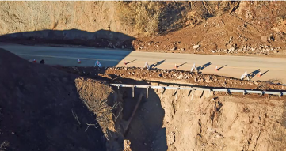
Presentation: Caltrans Drone Program
Alan Sharon
Unmanned aerial systems maintenance
applications
  Wildfire response
  Landslide and rockfall mitigation
  Crash response
  Encampment documentation
  Hazmat response
  Culvert inspection
  Explosives
  Propellants
  Steep terrain mapping

Slide 13
Business and Planning Meeting
Commitments and transfers; budget and spending
Marketing planning and website updates
Recent additions and next steps for the innovation database
Informal surveys – process and semiannual wrap-up
Summer AASHTO MAC presentations (June webinar, July meeting)
Review of workforce shortage synthesis in progress
Next peer exchanges: fall 2022 and spring 2023

Slide 14
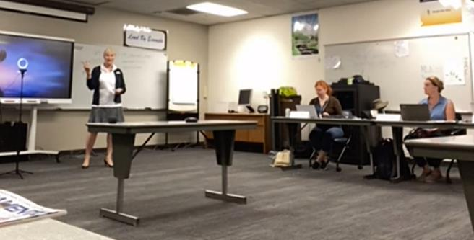

Presentation: American Public Work Association
Helena Allison, APWA Technical Director, Transportation
Overview, mission and scope of APWA and its membership
Possible future links between APWA, No Boundaries, LTAPs

Slide 15
Round Table 4. Supply Shortage
Supply shortages are a big issue
  Components, building materials, and consumables (salt)
  “Cannibalization” of equipment for parts and sharing materials across regions
  Difficulty in keeping LOS, but all are working hard to do so
Price increases — order early and plan ahead
Innovating contracting
  Drive to a neighboring state for materials (salt)
  Perform work that can be done with fewer trucks, or work that doesn’t require trucks
  Add penalties to contracting for late delivery or nondelivery
  Decouple shipping and materials costs
  Remove expensive, noncritical items

Slide 16
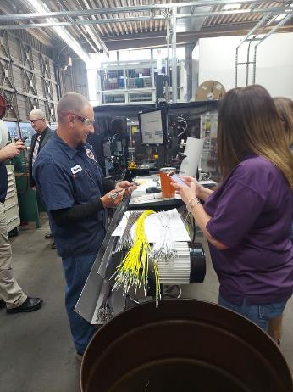
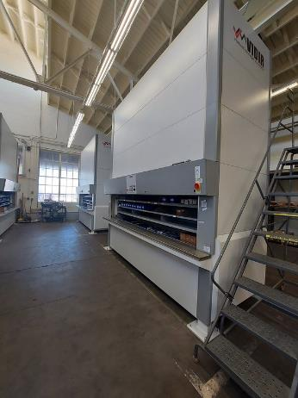
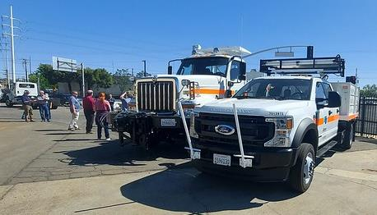
Technical Site Visits
Caltrans HQ Equipment Shop Sacramento, CA—Technical tour
Maintenance Training Academy Back Lot Hands-on demonstration and Q-and-A
Pictures available on Flickr

Slide 17
Takeaways
“Aha moments,” big takeaways and great ideas to borrow or learn more about came from all portions of the meeting
  Presentations
  Roundtable discussions
  Technical tours
  Informal and offline networking
Need for additional strategic definition and direction for Year 3 and beyond
Future Meetings
New York State in Fall 2022
Missouri in Spring 2023

