Slide 1

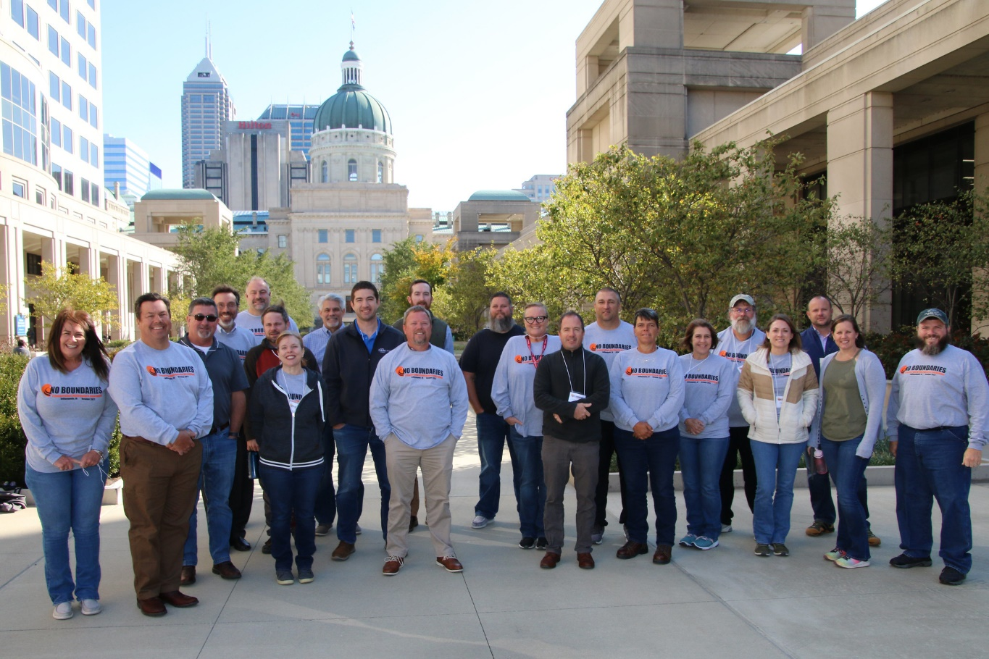
October 2022 Peer Exchange
No Boundaries held its second peer exchange of 2022 on October 18 and 19
  Hosted by Indiana DOT
  In-person meeting in Indianapolis
Meeting information at maintainroads.org/october-2022-indianapolis/
  Detailed documentation available for members with login

Slide 2
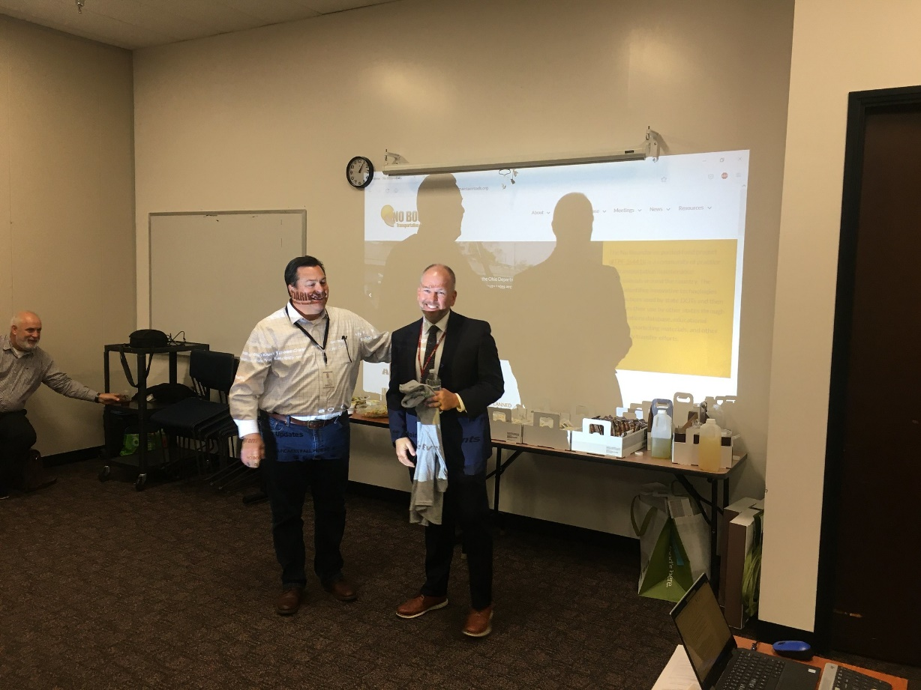
Indiana DOT Welcome and Overview
Indiana DOT Welcome
  Mike Smith, Commissioner, Indiana DOT
  J.D. Brooks, Deputy Commissioner of Operations, Indiana DOT
  Todd May, Director of Department of Innovation
Current INDOT challenges and opportunities
  Staff recruitment
  Process Improvements
  Implementing INDOT innovations
    Intelligent Brine System releases brine automatically
    Laser Guide System for tow plows and wing plows
Indiana DOT Commissioner Mike Smith (right) and Todd May (left)

Slide 3
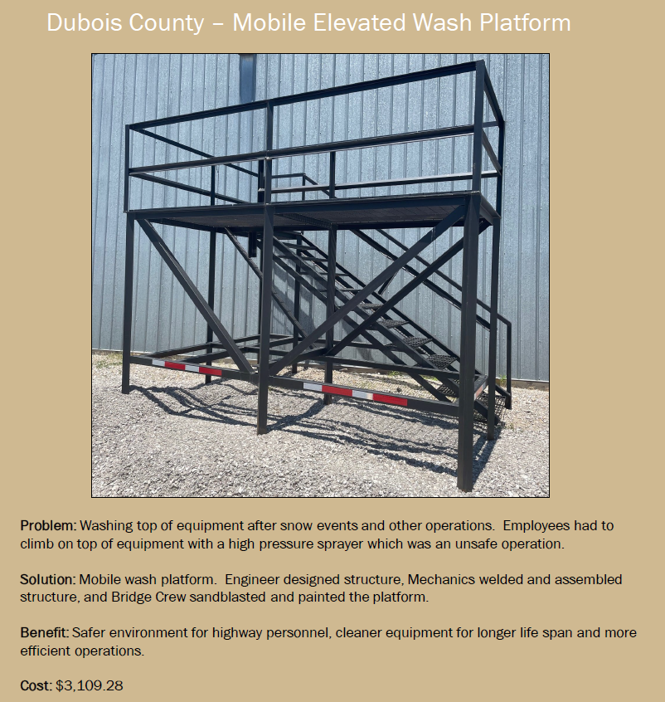
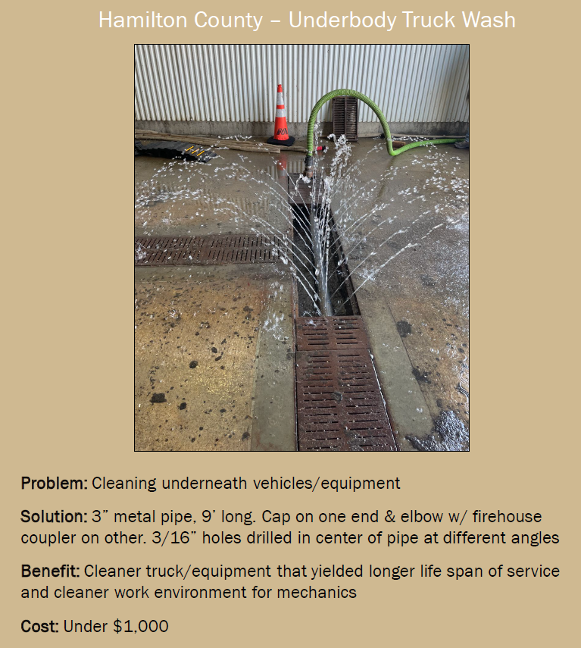
Presentation: Indiana Local Technical Assistance Program (LTAP)
Rich Domonkos, Program Manager
History of Indiana’s LTAP
  Started in 1959
  Partners with Purdue University
  Used as a model for the National LTAP program
Overview of research and innovation programs
  New program launched in 2021 to implement innovations at the local level
  Research is driven by local agencies’ needs
  Provides content for training and technical resources
Future opportunities and collaborations
  Masterminds Challenge
  Purdue Road School

Slide 4
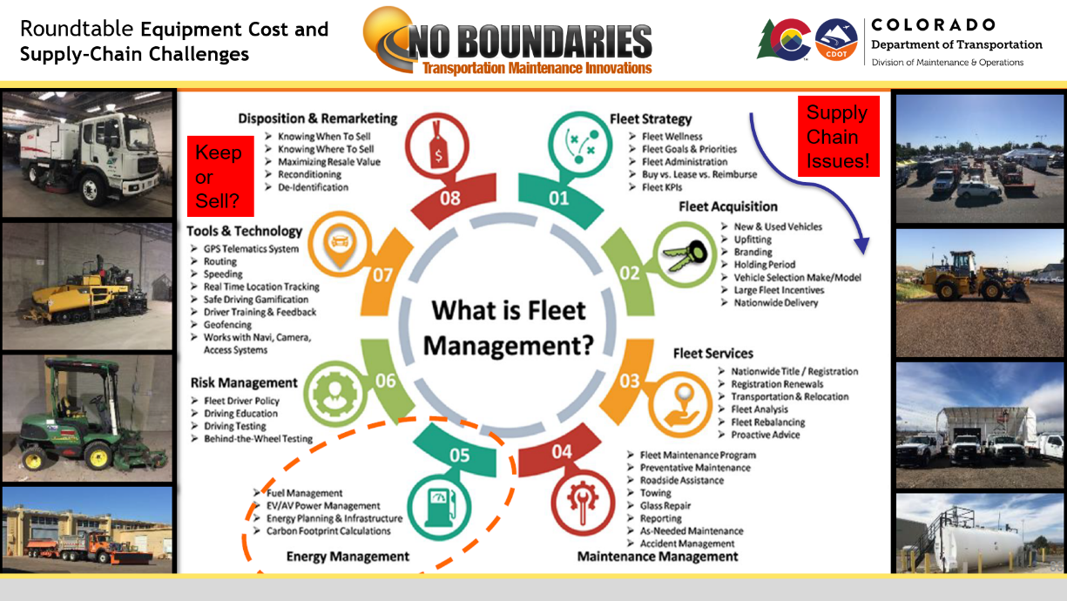
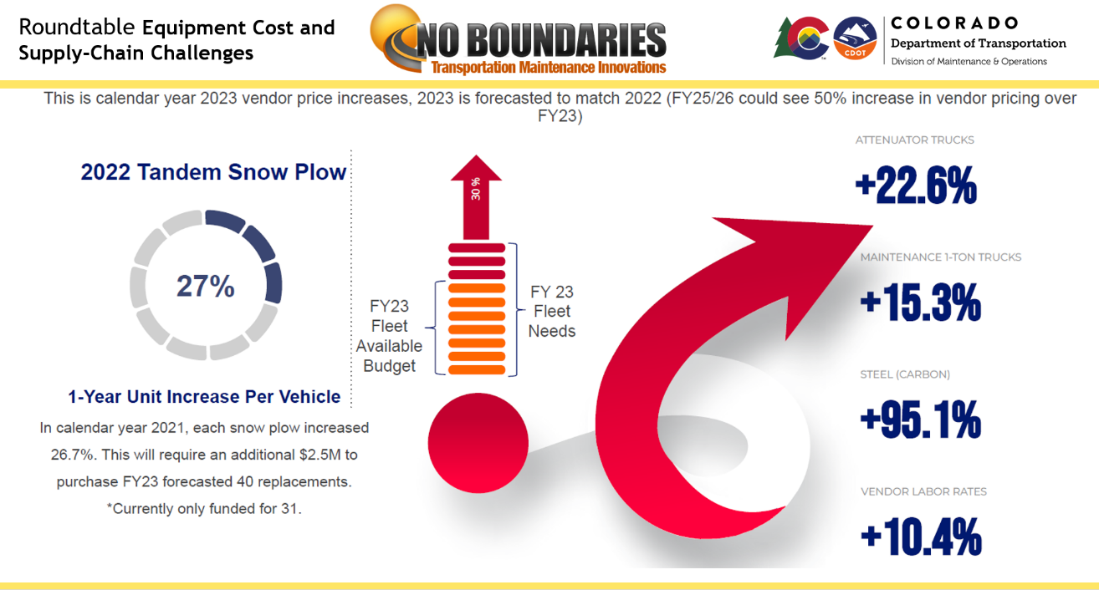
Round Table 1. Cost and Supply-Chain Issues
Challenges related to maintenance equipment
  Costs
  Availability/supply chain
Level of service impacts
Innovative solutions
  Keeping existing equipment longer
  Spending more for repairs
  Refurbishing older equipment
  Other
Success of strategies

Slide 5
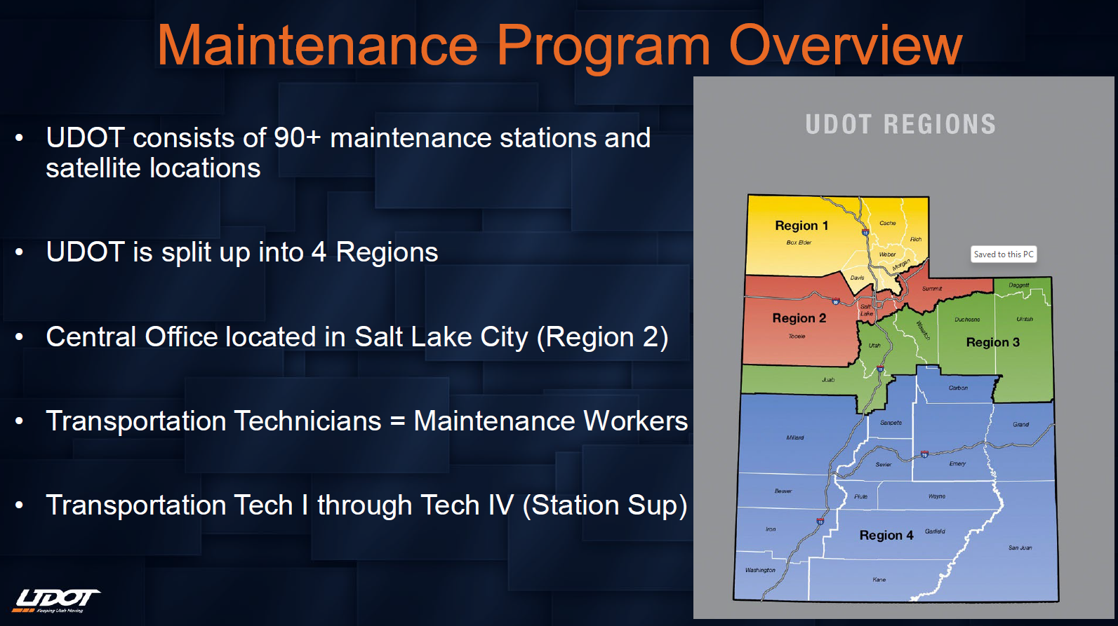
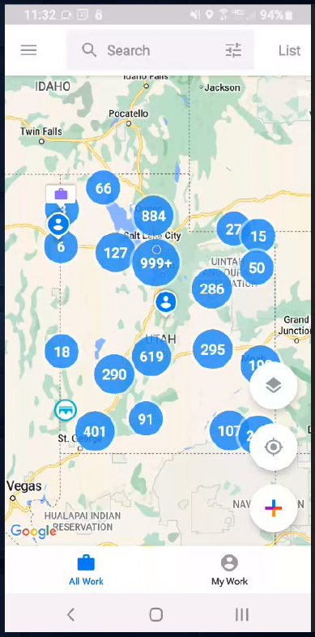
New member presentation: Utah DOT
Ryan Ferrin, Statewide Maintenance Engineer
Maintenance-related challenges
  Staffing
  Compensation
  Litter
  Striping
Strengths
  Staff training program
  UAS
  Durable Striping Program
  Asset management program
  (ATOM) ►

Slide 6
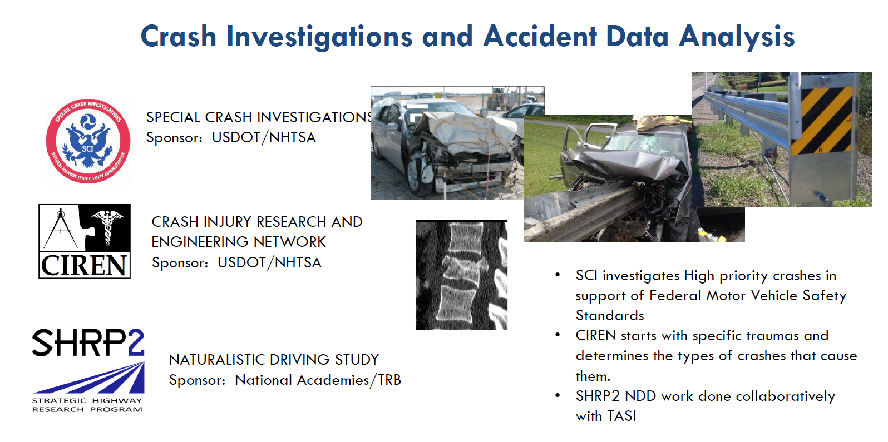
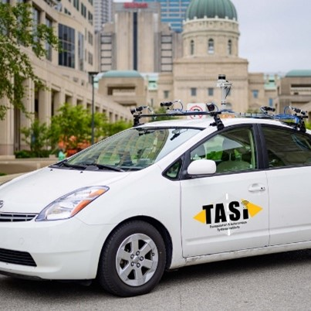
Presentation: Transportation and Autonomous Systems Institute (TASI)
Clayton Nicholas, Associate Director for Engagement and Partnership
Conducts crash testing to learn prevention strategies
Develops test systems to validate connected and automated vehicles
Areas of study
  Road departure testing
  Predictive modeling
  Road patching

Slide 7
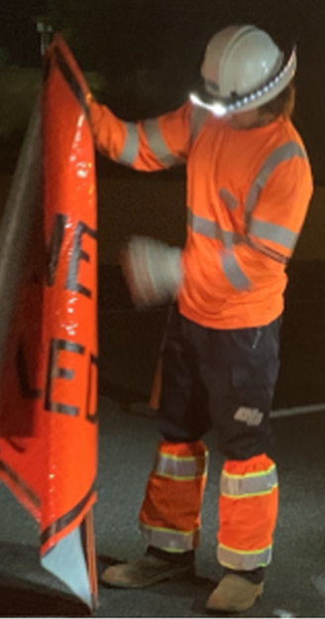
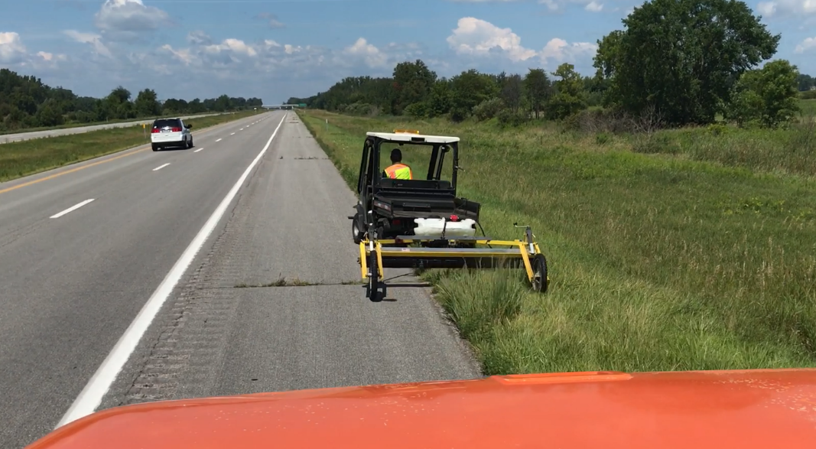
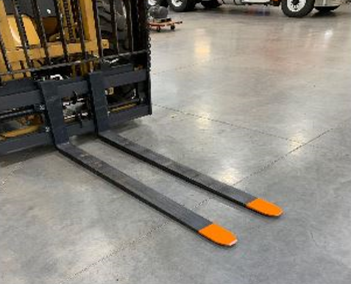
Round Table 2. Innovation Show-and-Tell
Selected Highlights
HI-VIZ gaiters(California) ►
  Enhanced nighttime visibility for workers
Weed Wiper (Michigan) ►
  Warm-season grass control
Painted forklift tines (Colorado) ►
  Makes tines more visible and reduces tripping hazards

Slide 8
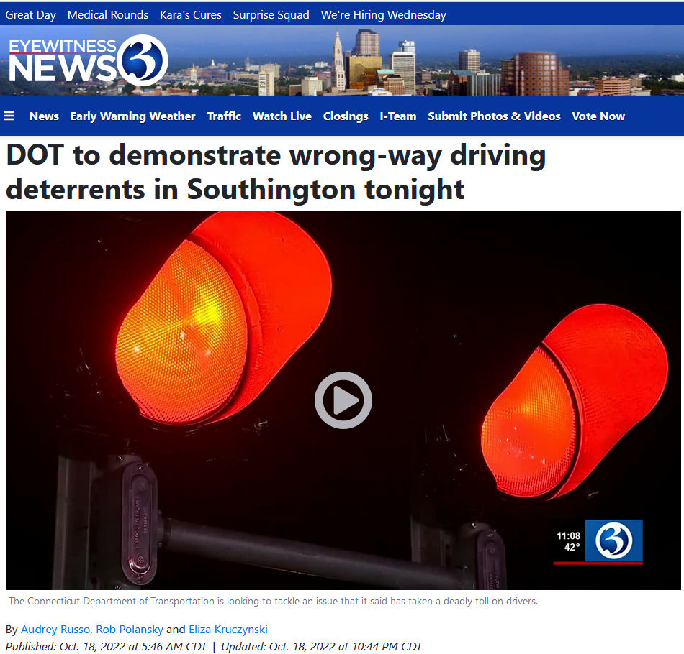
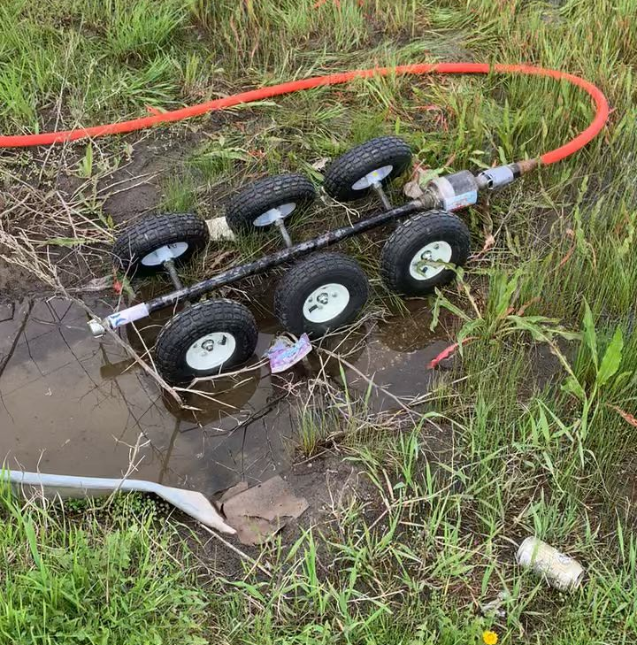
Round Table 2. Innovation Show-and-Tell
Selected Highlights
Flashing lights for wrong-way driving hot-spots (Connecticut) ►
  Demonstration featured on local news
Asset inventory collection and management (Mississippi)
  Currently exploring market options
Fleet Optimization Group (Ohio)
  Aiming to “right-size” the state fleet
Pipe Runner (North Dakota) ►
  Water-propelled culvert Inspection tool

Slide 9
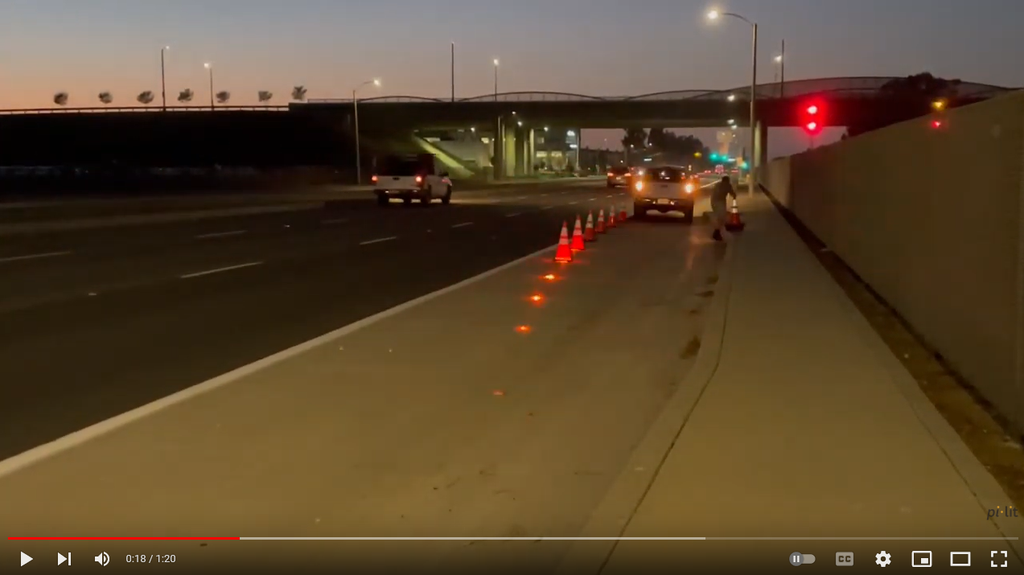
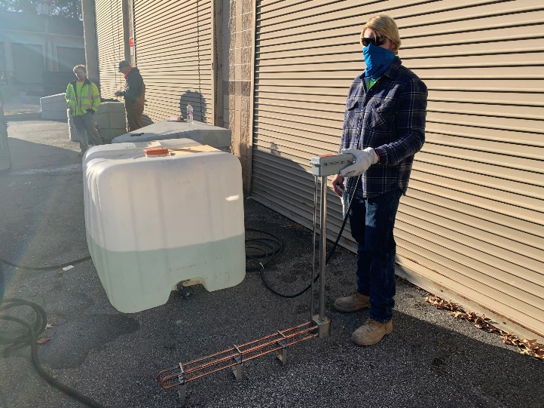
Innovation Show & Tell continued
pi-lit Smart Sequential Flares (South Carolina) ►
  Deployed underneath traffic cones
Traffic Speed Deflection Device (Texas)
  Uses laser to collect pavement condition data
Water tank heater for winter patching (Virginia) ►
  Keep water warm for winter patching
ATOM maintenance management system (Utah)
  Google Maps based inventory/work order/payroll system

Slide 10

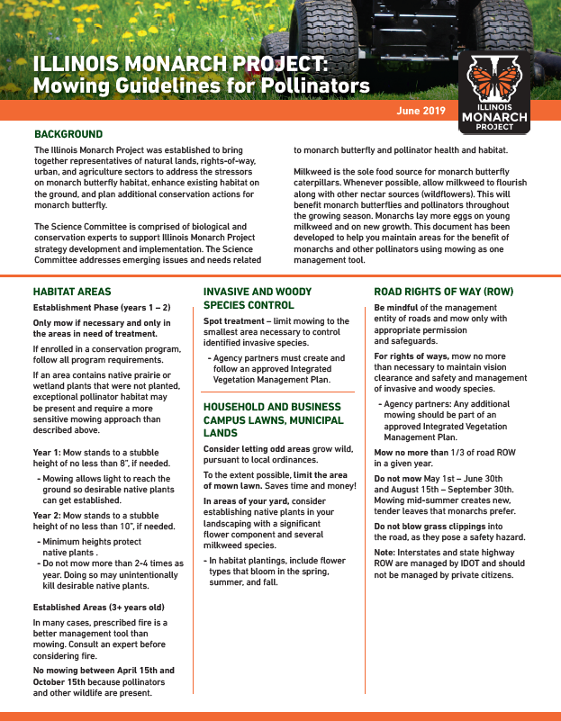
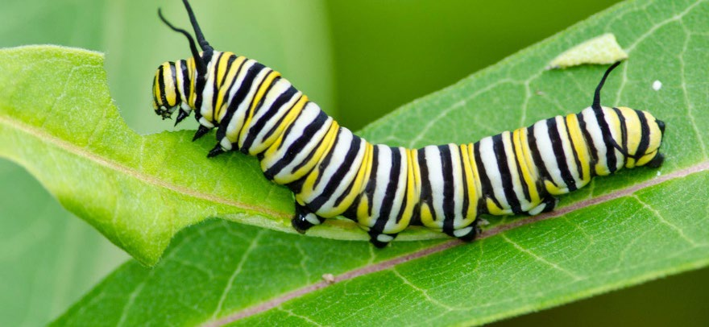
Presentation: National Pollinator Initiatives
Stephanie Dobbs, Illinois DOT
Candidate Conservation Agreement with Assurances (CCAA)
  Agencies can participate before a species is threatened
  CCCA only covers rights-of-way
  Cost for Illinois DOT to participate is $19k per year for 420,000 acres

Slide 11
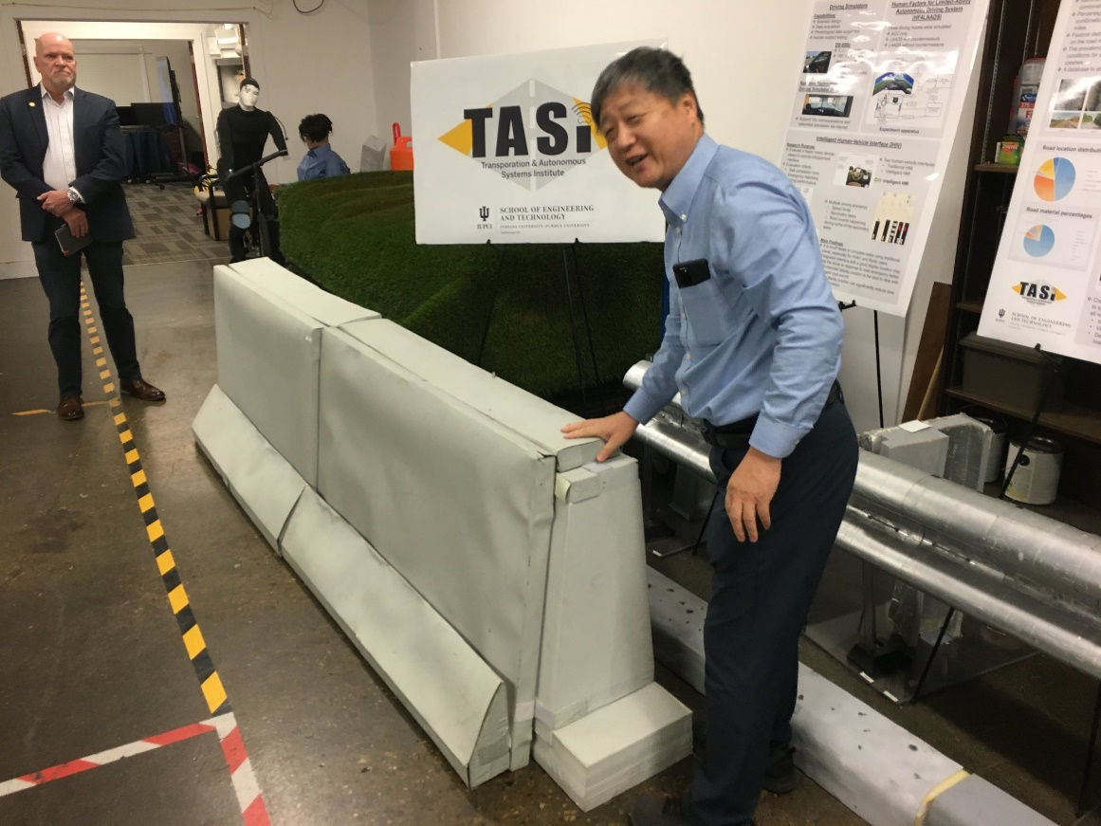
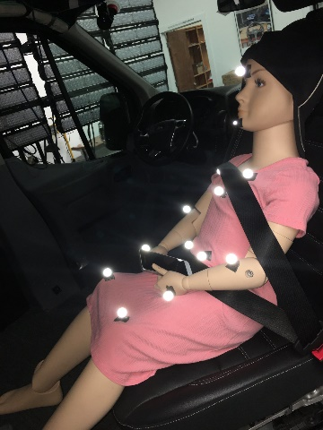
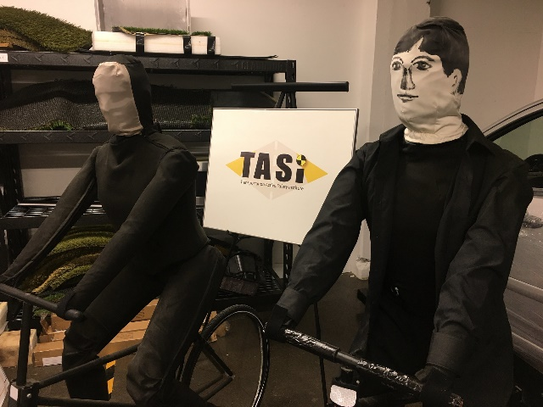
Technical Site Visit
Indiana University Campus
  Transportation and Autonomous Systems Institute
Pictures available on Flickr

Slide 12
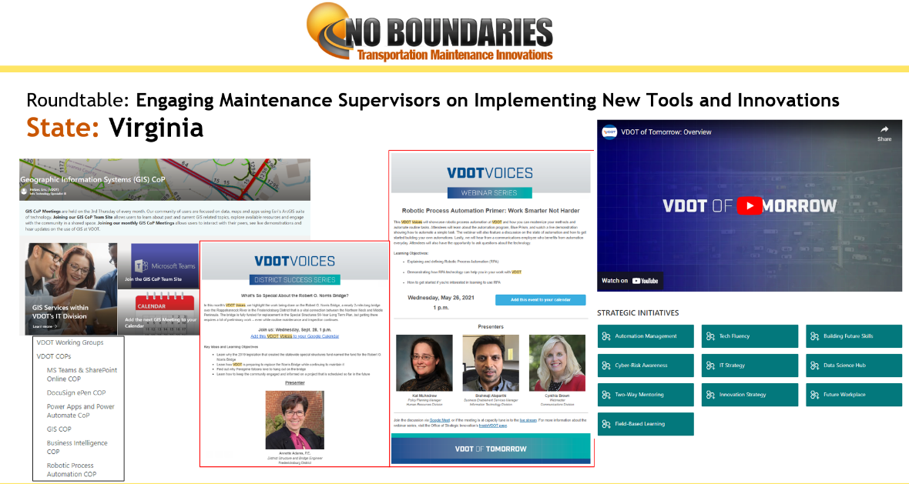
Round Table 3. Engaging Maintenance Supervisors on Innovations Selected Highlights
Agency processes for implementing maintenance innovations
  Created an Office of Strategic Innovations and Innovation Research Council (Virginia) ►
  Pilot projects, experiments or side-by-side experiments before adopting new technology or products (Utah)
What is working well? What are barriers?
  Sufficient funds, but not enough time (California)
  Inclusive innovation program, but staff may not feel their ideas are worth advocating (Ohio)

Slide 13
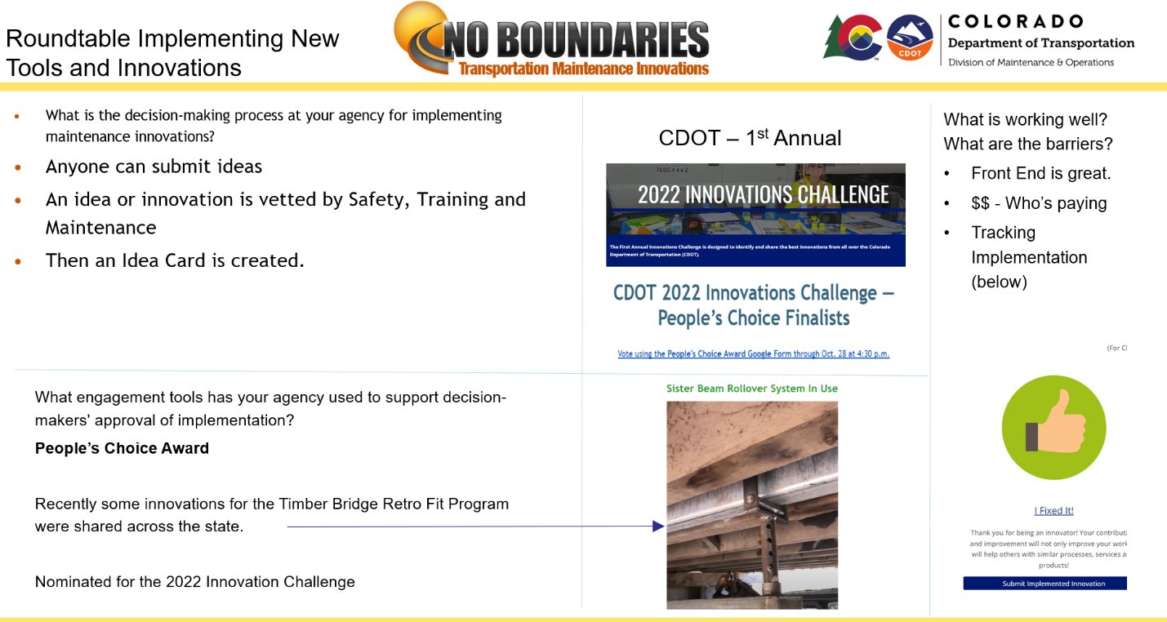
Round Table 3. Engaging Maintenance Supervisors on Innovations (continued)
What engagement tools has your agency used to support decision-makers’ approval?
  Demonstrations, presentations, lunch-and-learns (Indiana)
  TeamUP ODOT showcases innovations and award winners across all disciplines. (Ohio)
  People’s Choice Award (Colorado) ►

Slide 14
Business and Planning Meeting
Commitments and transfers; budget and spending
Planning for the second half of Year 3 and beyond
  Reviewed results of member survey on Mission and Scope
  Revised the group’s mission statement and goals
    No longer explicitly excluding winter innovations from No Boundaries
    However, snow-and-ice research remains a focus for Clear Roads and others
  Discussed current activities, future plans, and priorities
Review results of informal member email surveys
Marketing plan and website updates
Open seat on Steering Committee filled by Todd May, Indiana DOT
Possible hosts for future peer exchanges; possible lead state for Phase IV of No Boundaries

Slide 15
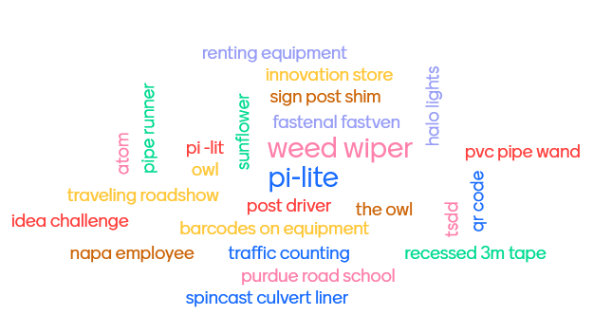
Takeaways
Name an innovation you saw that you'd like to borrow for your own agency...
“Aha moments,” big takeaways and great
ideas to borrow or learn more about came
from all portions of the meeting
  Presentations
  Roundtable discussions and
  innovations highlights
  Technical site visits
  Informal and offline networking
Opportunities for new directions and initiatives in Year 3 and beyond
Next Meeting
St. Louis, Missouri in Spring 2023

