Slide 1
No Boundaries Transportation Maintenance Innovations Pooled Fund maintainroads.org Overview and Update SICOP Maintenance Operations Briefing June 28, 2022 Doug Gruver, Ohio DOT Heath Patterson, Mississippi DOT
Notes:
W

Slide 2
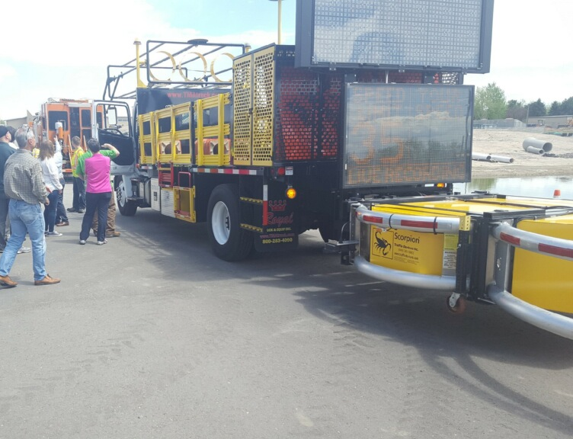
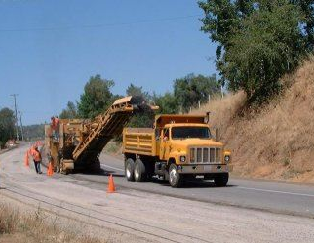
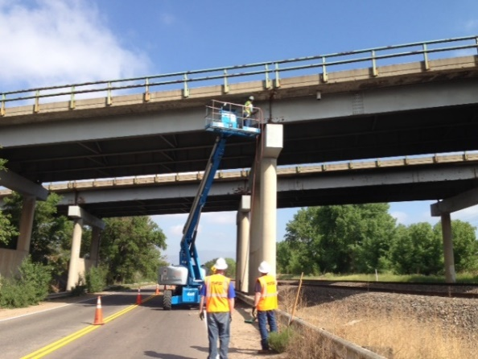
Presentation Overview
What is No Boundaries?
Purpose, goals and history
Members and partners
Highlights of how No Boundaries can help agencies share innovations and information
Peer Information Sharing
Innovation Database
Staffing Shortage Synthesis

Slide 3
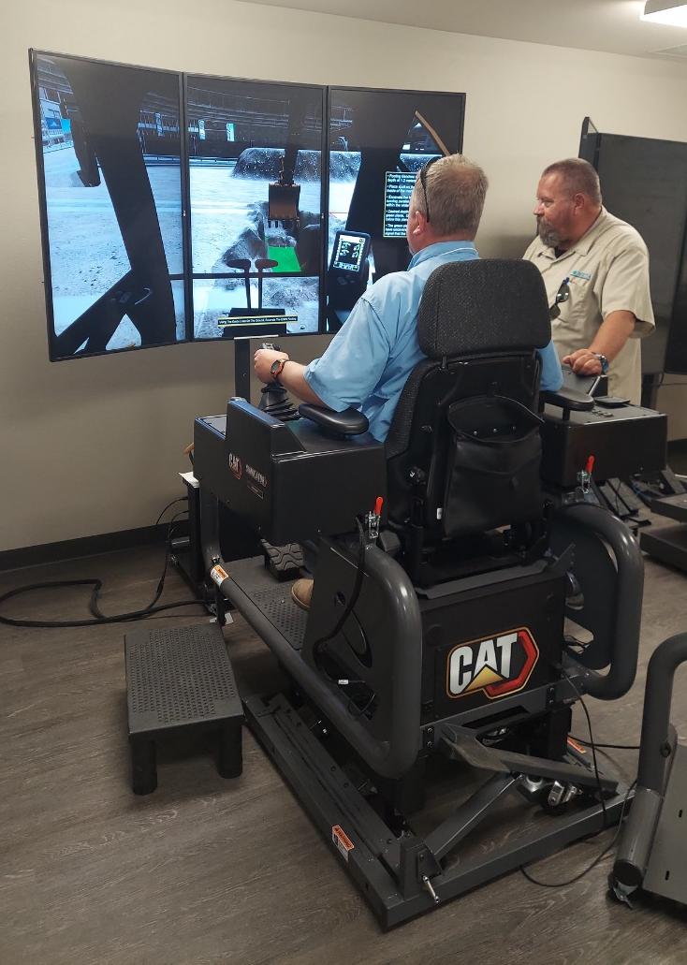
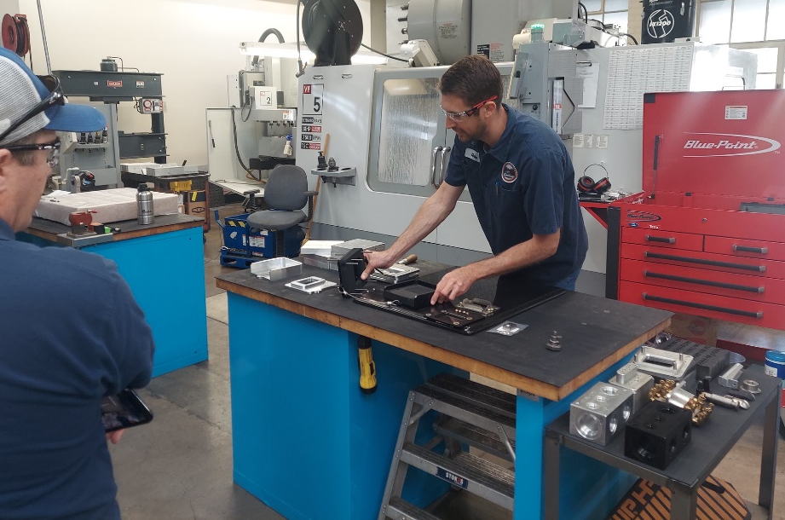
Purpose
The No Boundaries pooled fund project (maintainroads.org) is a community of practice for transportation maintenance professionals around the country.
The group identifies innovative technologies and practices used by state DOTs and then promotes their use by other agencies.

Slide 4
Purpose
Note that No Boundaries...
Complements AASHTO MAC, the AASHTO Innovation Initiative, and other national efforts
Focuses on spring, summer and fall maintenance topics. Winter-specific topics are generally excluded except for “four-season” topics like workforce, contracting, etc.
No Boundaries
AASHTO MAC
AII

Slide 5
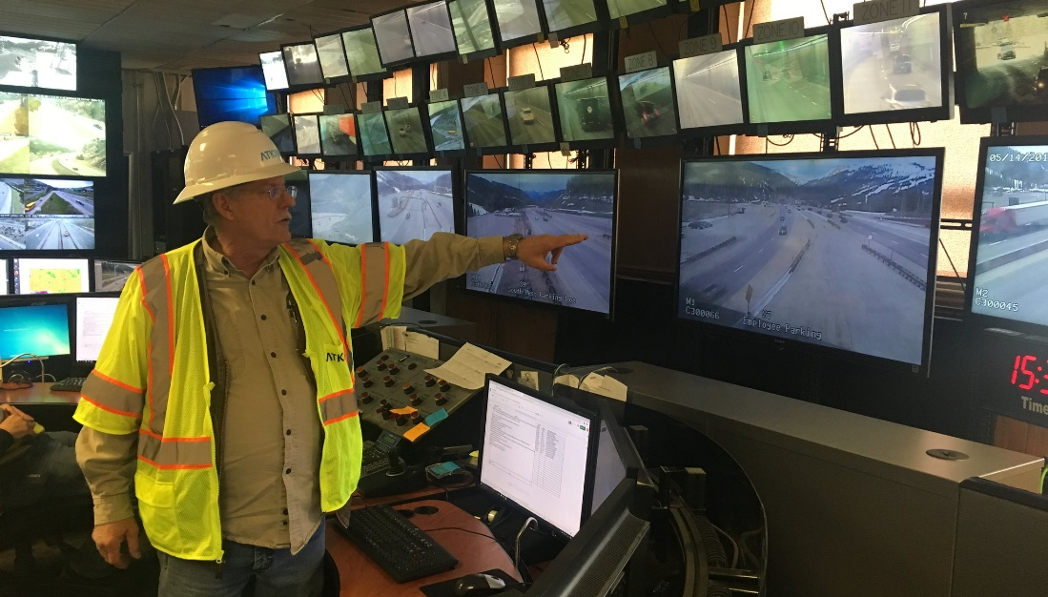
Goals
To help members share
Innovative equipment solutions
Innovative material solutions
Innovative process solutions
To increase network and collaboration among other agencies
Members learn firsthand: what works, what doesn’t (and why), what needs more investigation
To promote consistent maintenance activities among agencies
Align policies, procedures, and technologies... when it makes sense

Slide 6
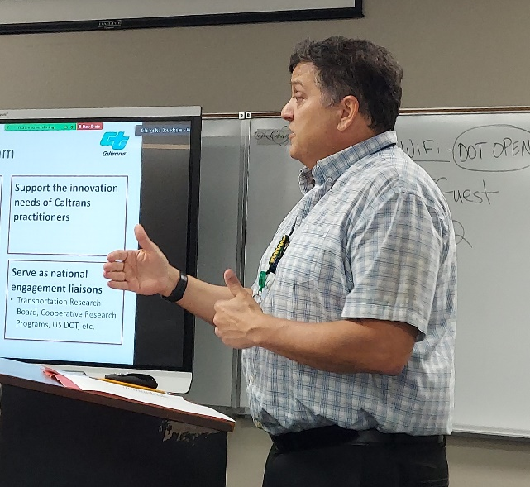
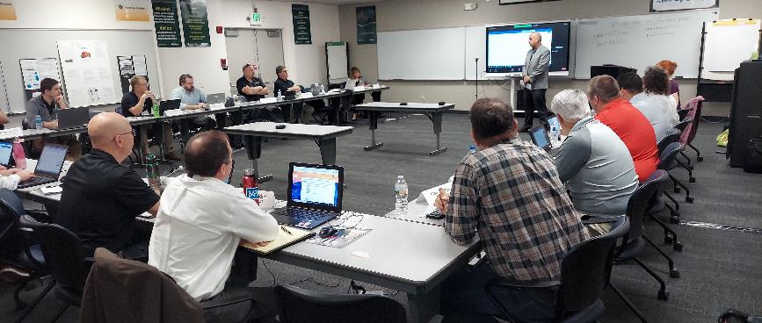
Goals
To facilitate meetings and in-person interaction
Provide a showcase for state innovations and technologies
Create a forum for direct questions and frank answers
To increase cost-effectiveness
Minimize duplication of effort
Maximize products and services

Slide 7
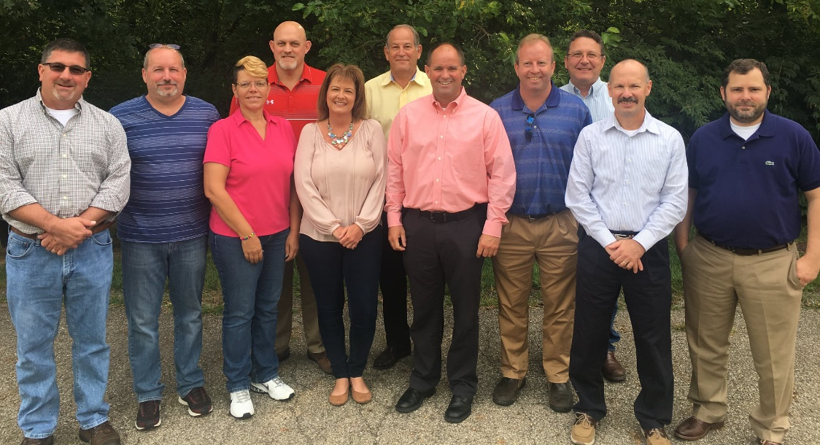
History
Began in 2011
Developing relationships with several DOT member states
Build synergy to address common challenges and opportunities among DOTs
No sense in “reinventing the wheel”
Share home-grown and off-the-shelf innovative solutions that work
Initially eight member states
Missouri and Ohio were previous lead states; currently led by Colorado

Slide 8
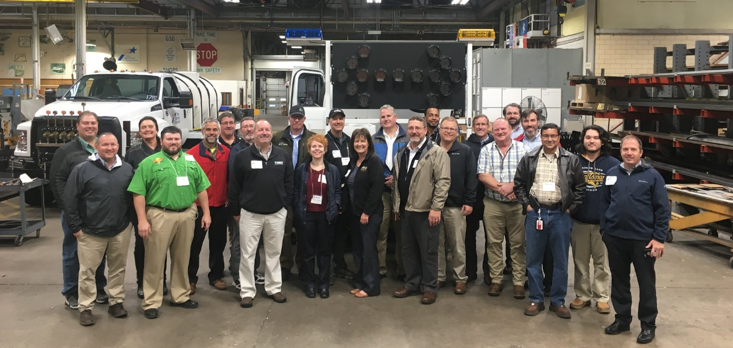
Today
21 member states
Focus areas include:
Core maintenance areas (bridges, pavements, operations, roadside, equipment)
Asset management for maintenance
Training, recruitment and retention
maintainroads.org documents all resources
Two meetings annually provide peer exchanges and technical site visits
Weekly news posts
Informal surveys of peer agencies

Slide 9
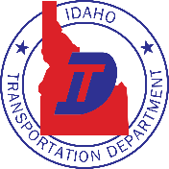
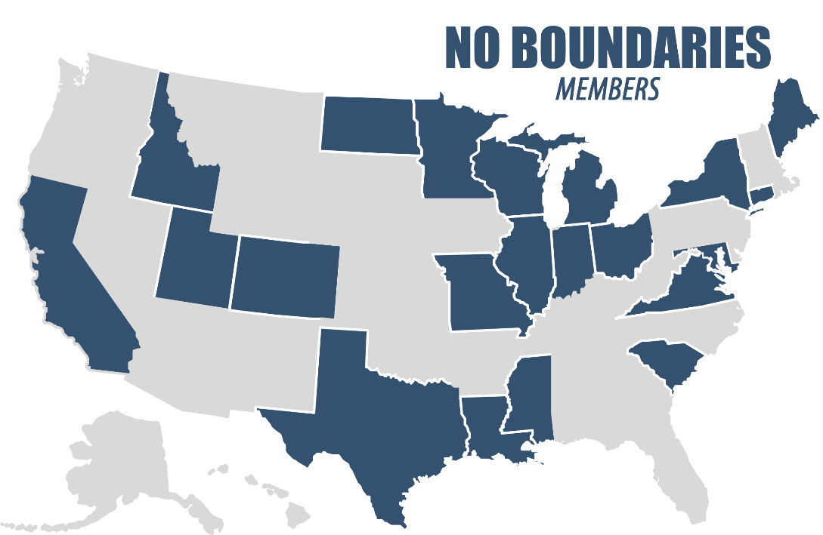
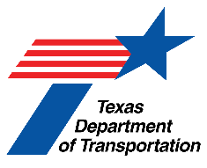
Current Member States
Past and Future Peer Exchange Sites

Slide 10
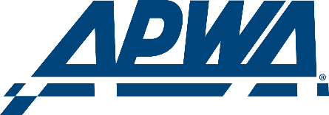
Current Partners and Liaisons
Federal Highway Association
AASHTO
Transportation Research Board
American Public Works Association
Front Range Community College (Colorado)
Clear Roads pooled fund

Slide 11
Highlighted Activities and Resources

Slide 12
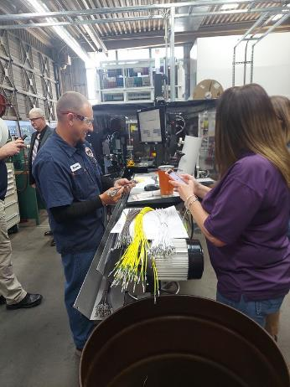
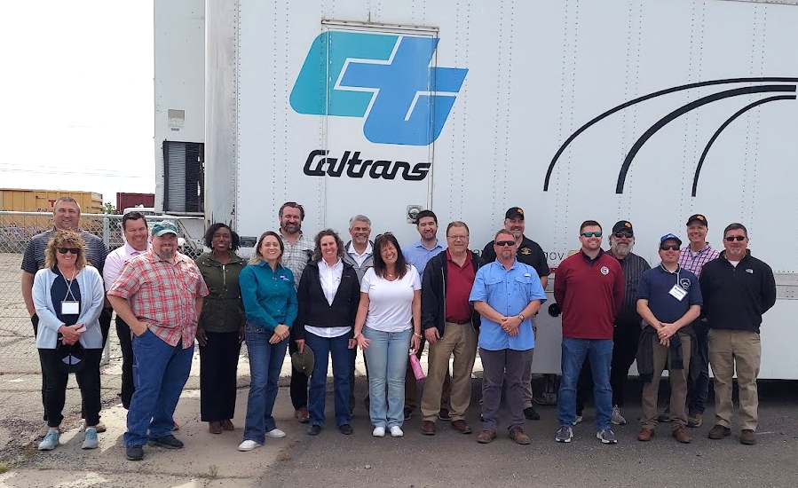
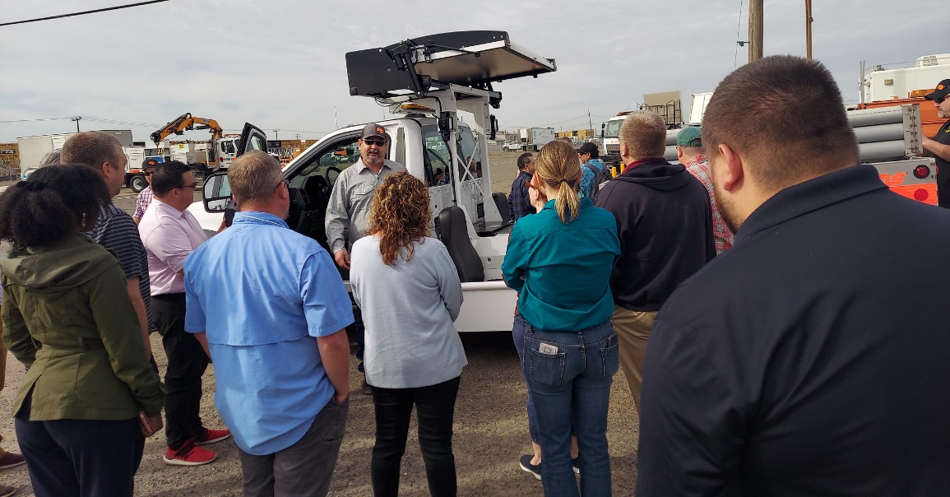
Peer Information Sharing
Three-day peer exchange and technical site visit in Sacramento in May 2022
Highlights
Technical presentations
Academic programs for high schoolers
Zero Emission Vehicles
Safety Innovations
Drones
Innovation show-and-tell

Slide 13
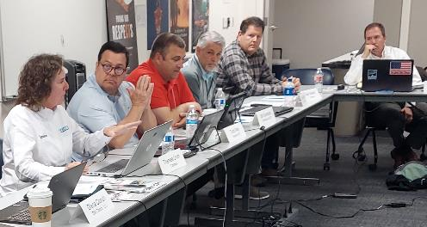
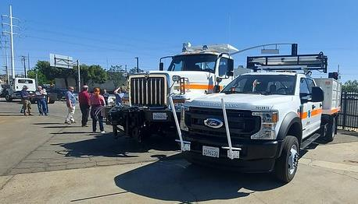
Peer Information Sharing
Highlights (continued)
Roundtable discussions
Guardrail repair best practices and issues
Impact of new commercial driver’s license requirements
Supply shortages
Technical site visits
Caltrans HQ Equipment Shop
Maintenance Training Academy Back Lot

Slide 14
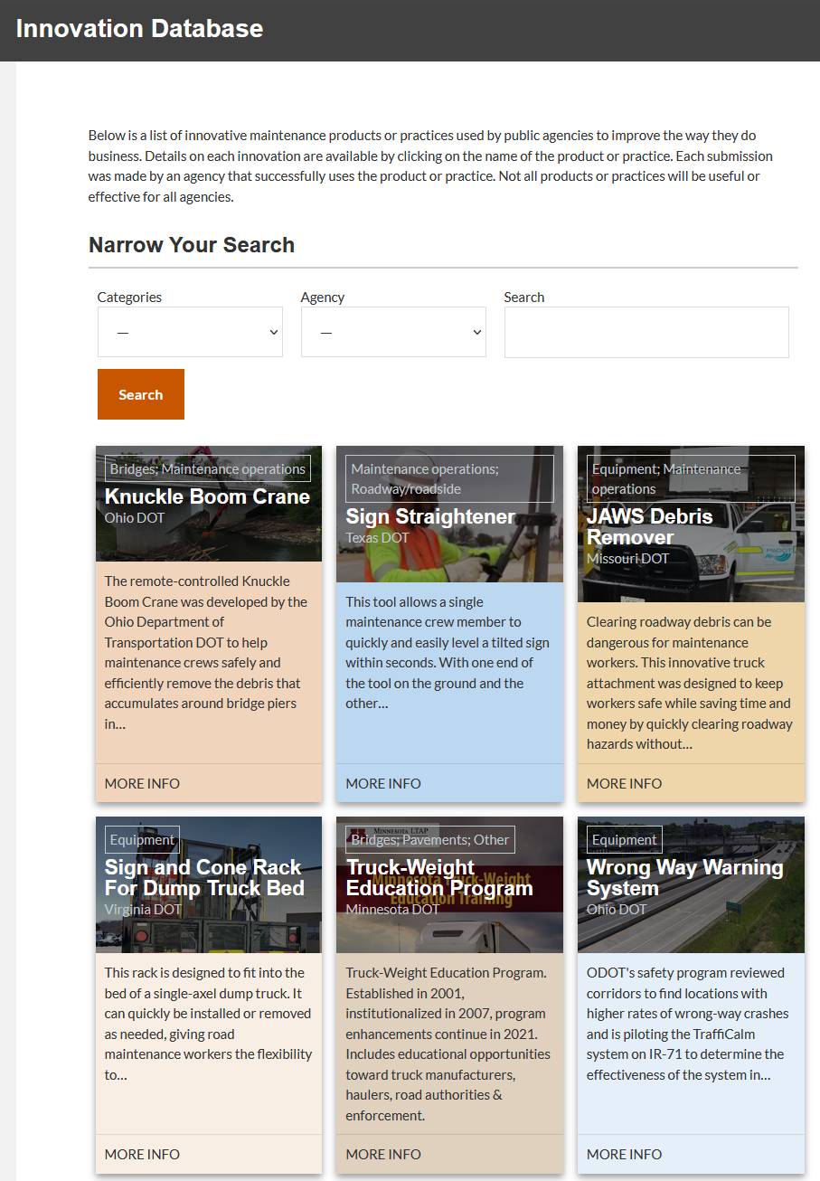
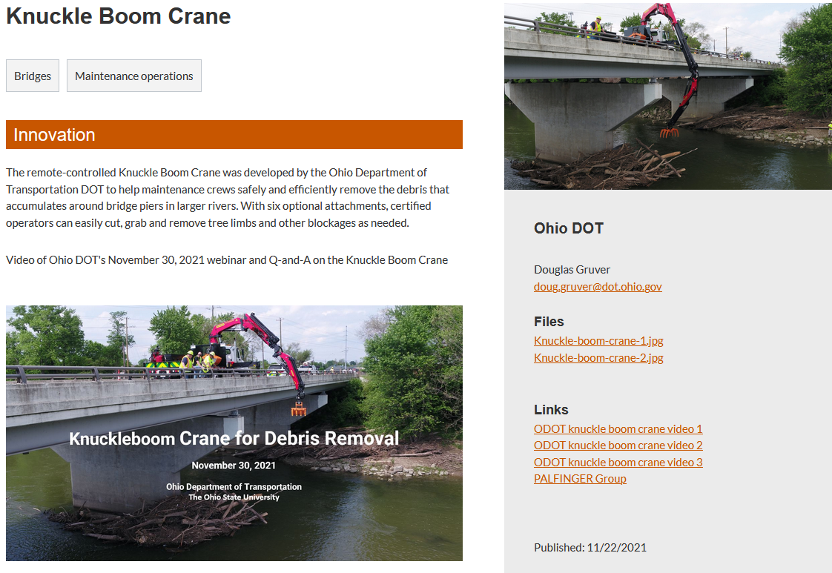
Innovation Database
No Boundaries’ Innovation database is a repository for successful innovative tools and practices
Topic areas:
Bridges
Equipment
Maintenance operations
Pavements
Roadway/ Roadside
Other

Slide 15
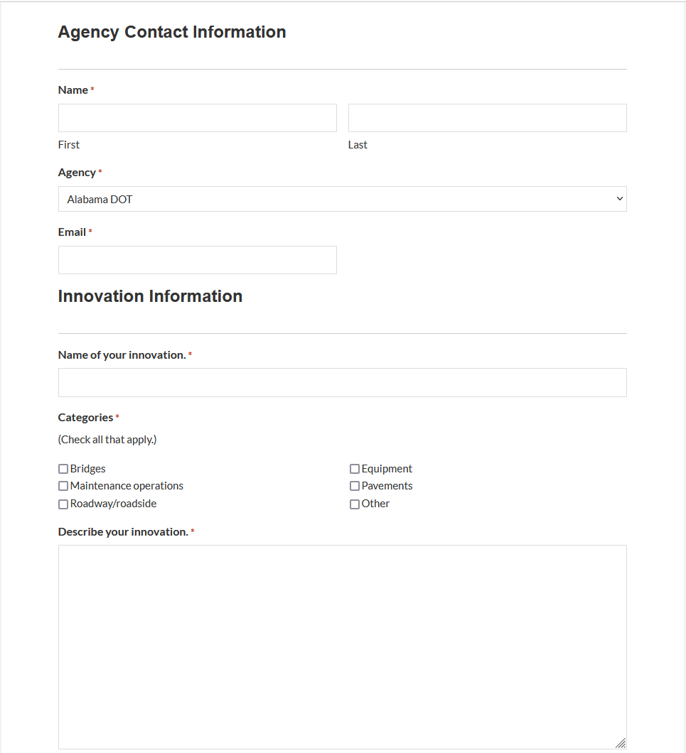
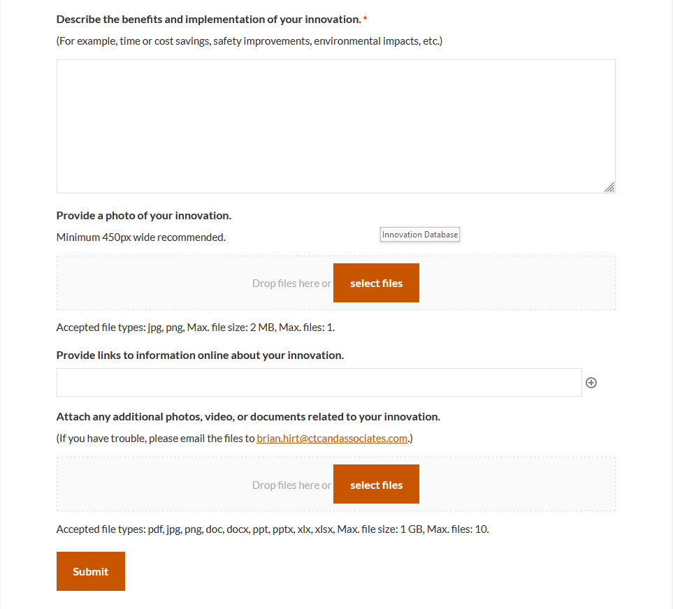
Innovation Database
Any agency can submit innovations

Slide 16
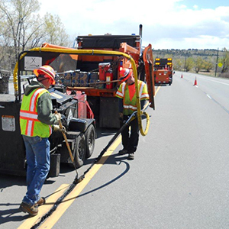
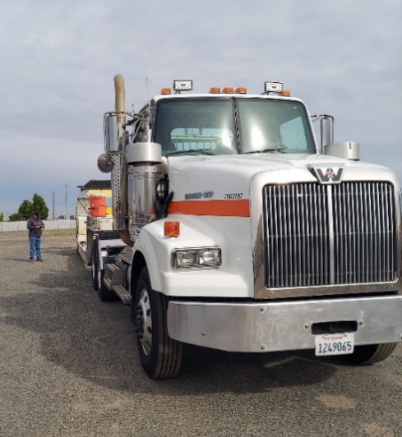
Staffing Shortages Synthesis
Quick-turnaround research effort examining impacts of maintenance staffing shortages
Focused on these topics:
Maintenance staffing levels, changes and trends
Agency short- and long-term impacts
Successful practices to expand applicant pools, recruit and retain workers
Impacts of new federal commercial driver’s license requirements
No Boundaries members and human resources staff were surveyed
Almost three-quarters of No Boundaries members responded
Final report will be available before the July 2022 MAC meeting on the No Boundaries website

Slide 17
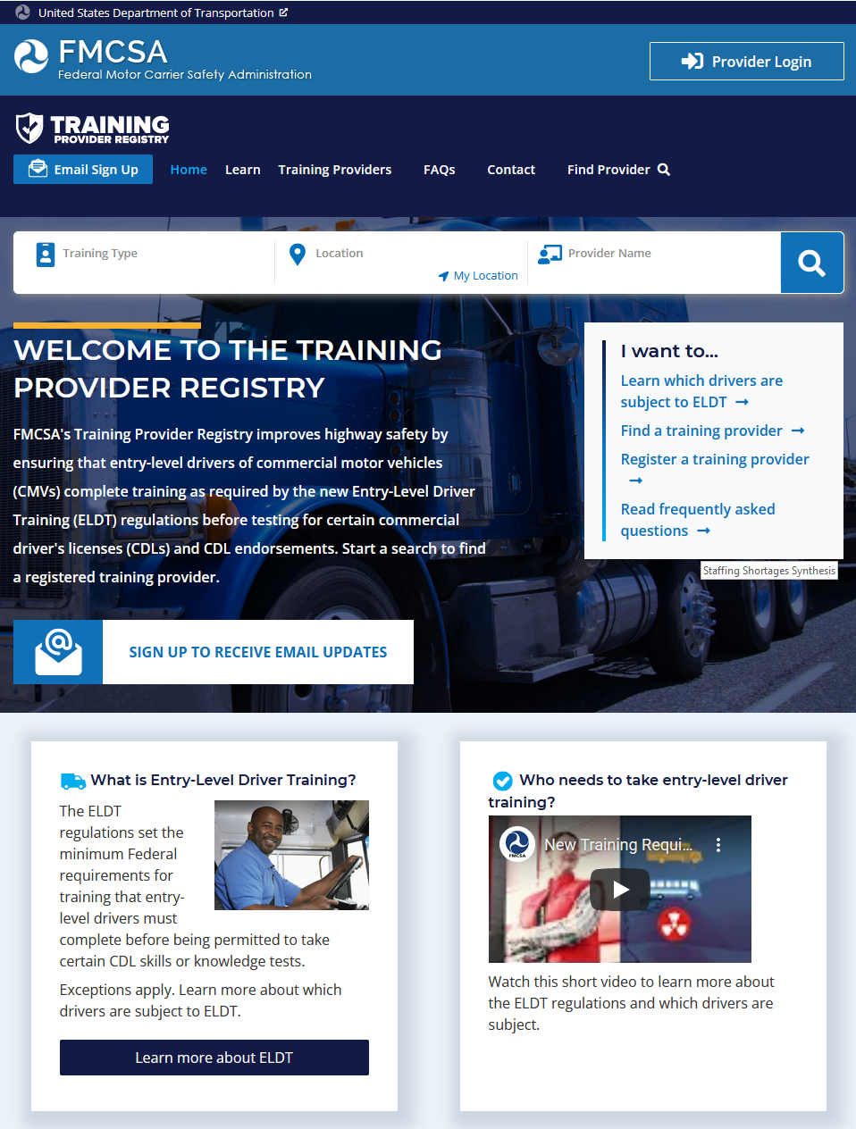
Highlighted Initial Findings
Most responding agencies have been short-staffed for three or more years
Recruitment and retention strategies can make a difference
Agencies are establishing new training programs or expanding existing ones
Many noted difficulty in attracting and retaining CDL-holding staff
One agency is considering a noncompete agreement after employees obtain a CDL through agency-provided training

Slide 18
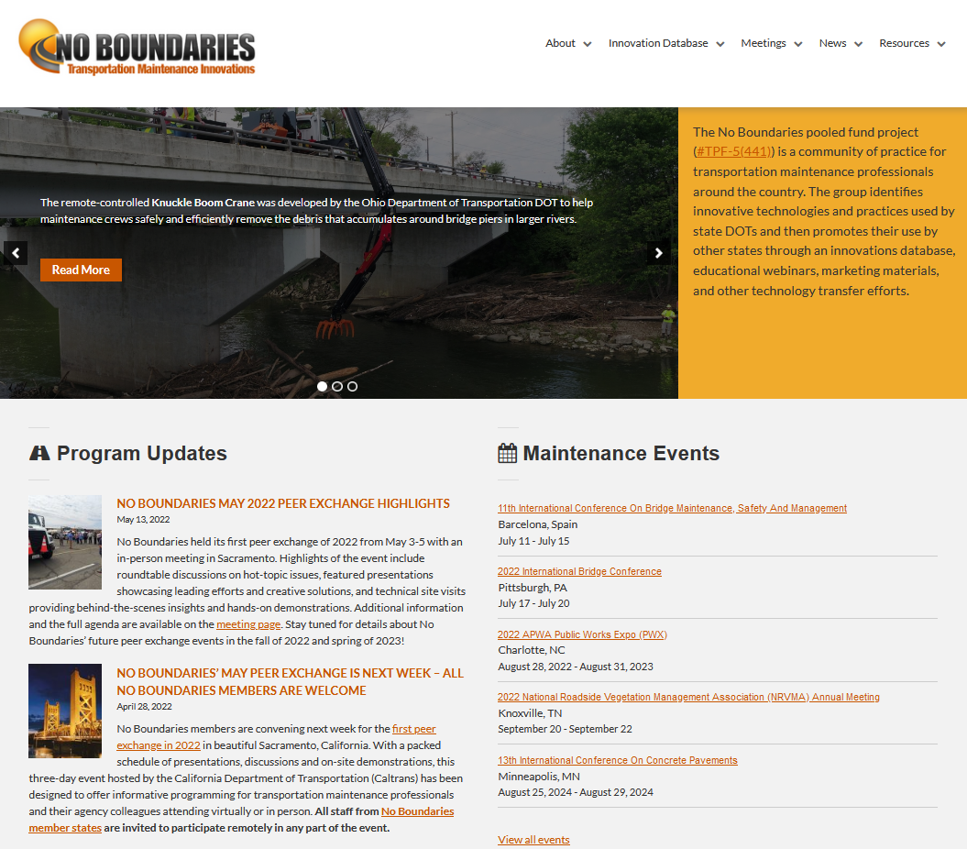
Learn More
Upcoming events
New York State in Fall 2022
Missouri in Spring 2023
On our website: maintainroads.org
Explore the Innovation Database
Subscribe for weekly news posts
View videos on YouTube
Photos available on Flickr
Contact us
Doug Gruver, Ohio DOT doug.gruver@dot.ohio.gov, 513-933-6606
Heath Patterson, Mississippi DOT hpatterson@mdot.ms.gov, 601-359-7113

