Slide 1

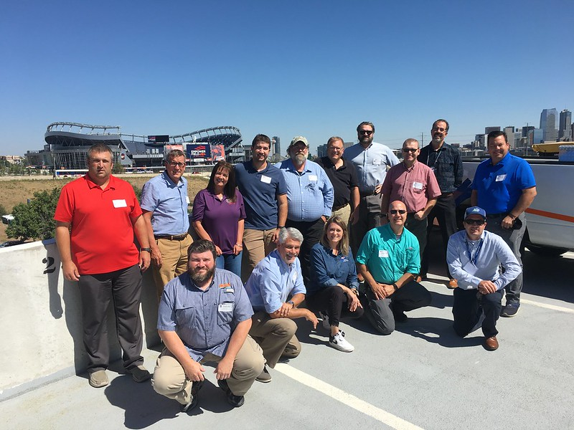
September 2021 Peer Exchange
No Boundaries held its second peer exchange of 2021 from September 14-15
  In-person meeting in Denver
  Simultaneous virtual option for remote participants
Meeting information at maintainroads.org/
september-2021-denver-co
  Detailed documentation available for members with login

Slide 2
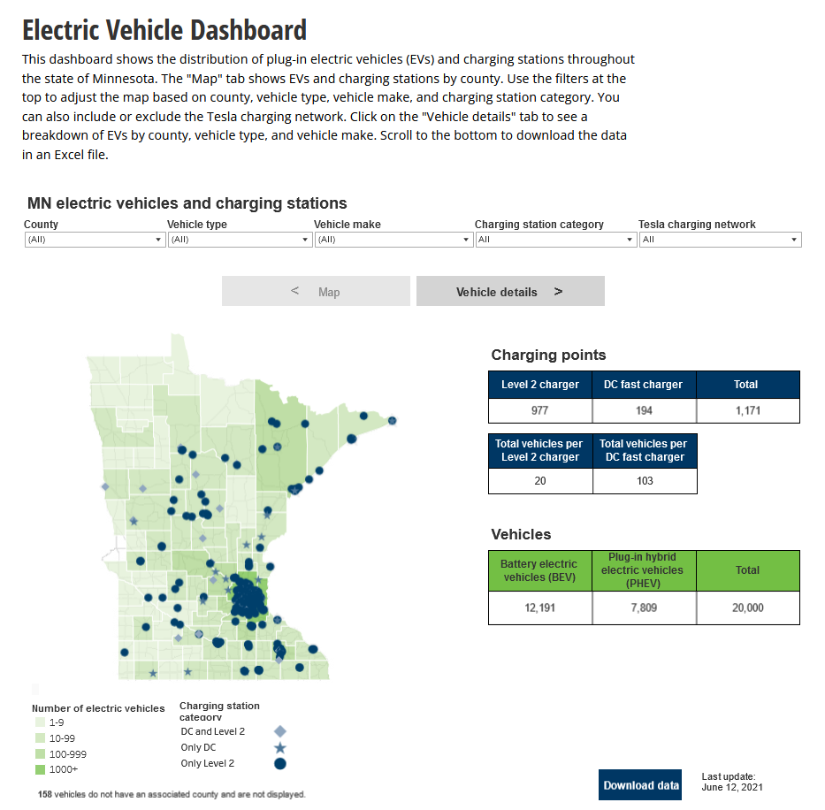
Three Round-Table Discussions
1. Electric Vehicles and Charging
  Plans, preparation and strategies for electrifying fleet EVs
  Issues related to serving the public with EV charging stations
  Discussion of federal ruling on EV charging at Interstate rest areas
  Detailed responses and documentation from CA, CO, CT, ME, MN, OH and TX
2. Drones/UAS in Maintenance
  Current and planned deployment, funding and training
  Detailed responses from CA, CT, MD, MI, MN, MS, OH and TX

Slide 3
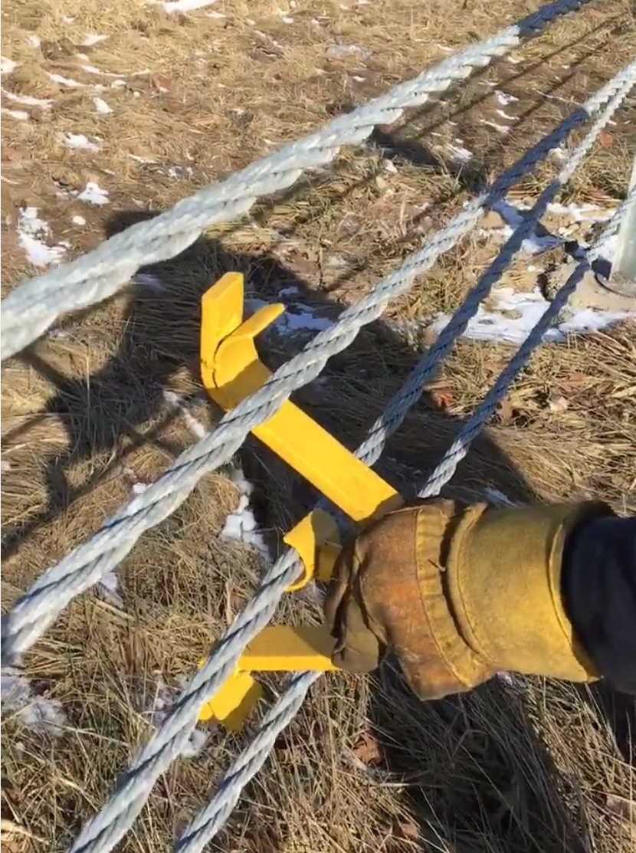
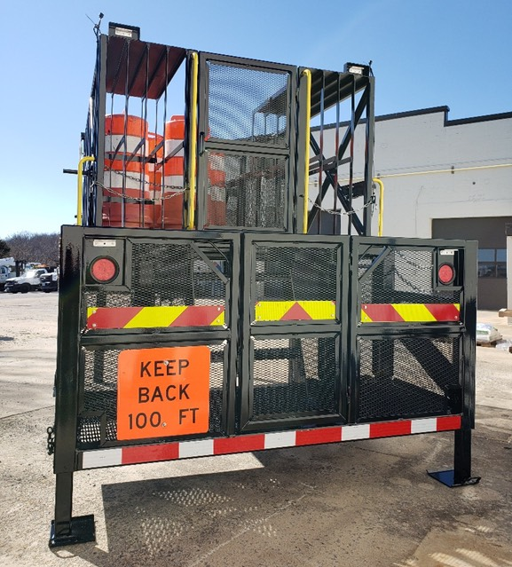
Three Round-Table Discussions
3. New Equipment Show-and-Tell
  Connecticut DOT – Excavator
  Indiana DOT – Cable Rail Spreader ►
  MaineDOT
    Plow/Cutting Edge Blade Holders
    Truck-Mounted Warning Sign Hitch Mount
    Hydraulic Pressure Reliever Tool
  Michigan DOT – Remote-controlled vessels for bridge inspections
  Minnesota DOT – Electronic Delamination
  Ohio DOT – Knuckle Boom
  Texas DOT – Sign Straightener
  Virginia DOT – Cone and sign rack ►

Slide 4
FHWA Updates
Maintenance innovation summit
Pavements
  Pavement Maintenance Techniques: Best Practices Field Guide
  Pavement Maintenance e-newsletter
  Strategic Plan for Pavement Preservation
  Use of RAP in Pavement Preventive Maintenance Treatments
NHI
  NHI Maintenance Leadership Academy six-module course
  Future NHI course: Leveraging your MMS

Slide 5
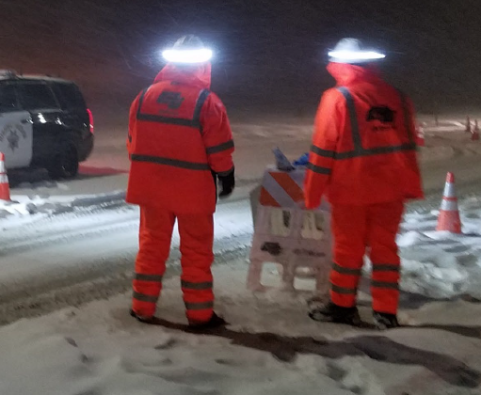
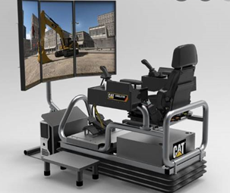
Caltrans Maintenance Program
Role in meeting state ZEV mandate
Maintenance innovations:
  Halo lights ►
  Advance warning vehicle
  with alarms
  Sequential lights for tapers
  Equipment simulators ►
  Reflective cone bases

Slide 6

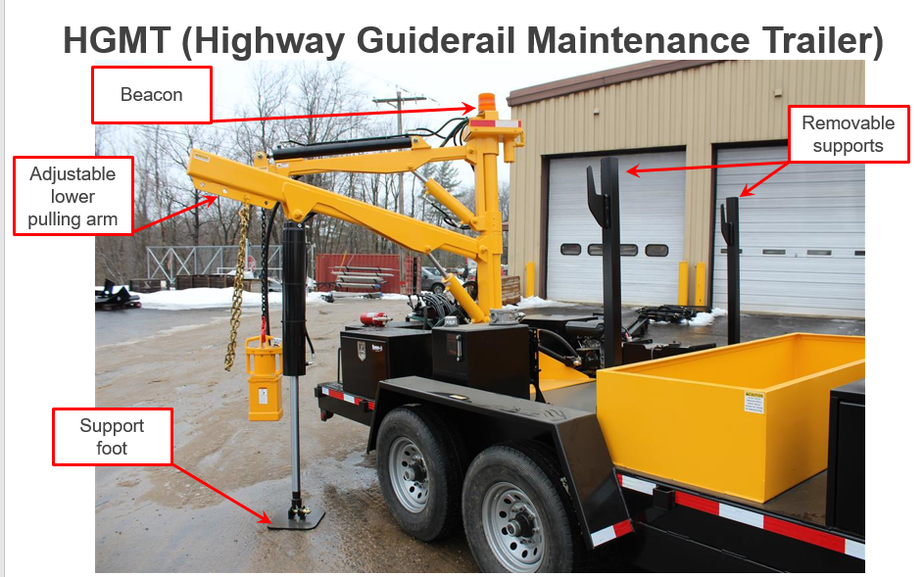
New York State DOT Guardrail Program
Training
Equipment
Asset management

Slide 7
Business and Planning Meeting
Steps for finalizing and launching the new Innovation Database
Plans for a synthesis report on impacts of staffing issues
  Building on a Clear Roads study on recruitment/retention, look at successful strategies for dealing with staffing shortages
Possible partnerships with FHWA
Peer Exchanges in 2022
Other new activities for Year 2 of the pooled fund

Slide 8
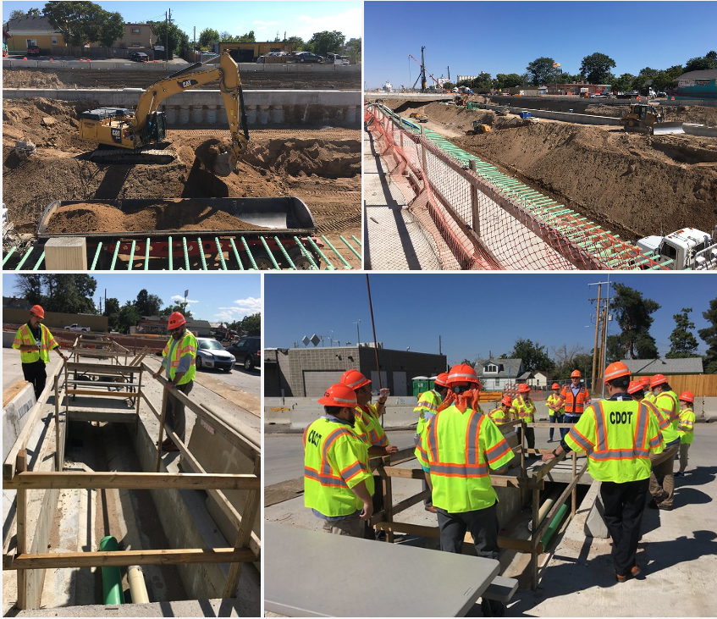
Technical Tour
Site visit to Central 70 Project
  Review progress made on the reconstruction and expansion of Interstate-70
  Discussion of special challenges and solutions
  Pictures available on Flickr

Slide 9
Takeaways
In-person meeting is invaluable
  Opportunities for Q-and-A, side-conversations, and frank discussion about challenges
  Learn who is facing similar issues; build a network of peers
Many attendees plan to take back innovations and ideas learned at the meeting (some had already done so before the meeting was over)
Technology remains a challenge for those attending virtually

