Slide 1


Slide 2
TREE TRIMMER PLATFORM
TREE TRIMMER PLATFORM
  What is a tree trimmer platform
  Where did the idea come from
  How did we get where we are with the platform

Slide 3
TREE TRIMMER PLATFORM
WHAT IS A TREE TRIMMER PLATFORM?
It is a dump truck attachment that was created about 25 years ago by VDOT.
These platforms would fit on the back of a dump truck and allow maintenance crews to safely and easily access tree limbs needing to be trimmed.

Slide 4
TREE TRIMMER PLATFORM
WHERE DID THE IDEA FOR
PLATFORMS COME FROM
VDOT maintenance crews worked together, came up with ideas and designed the first Tree Trimmer Platform.

Slide 5
TREE TRIMMER PLATFORM
Examples

Slide 6
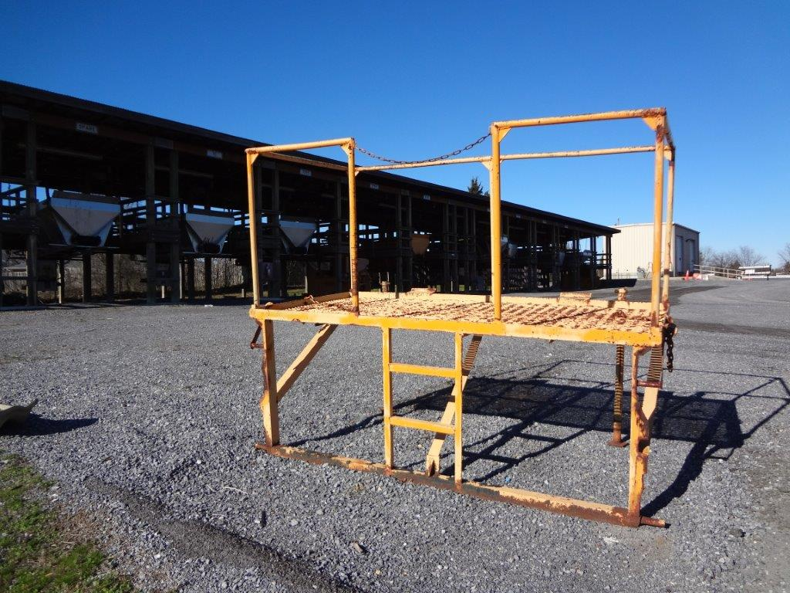

Slide 7
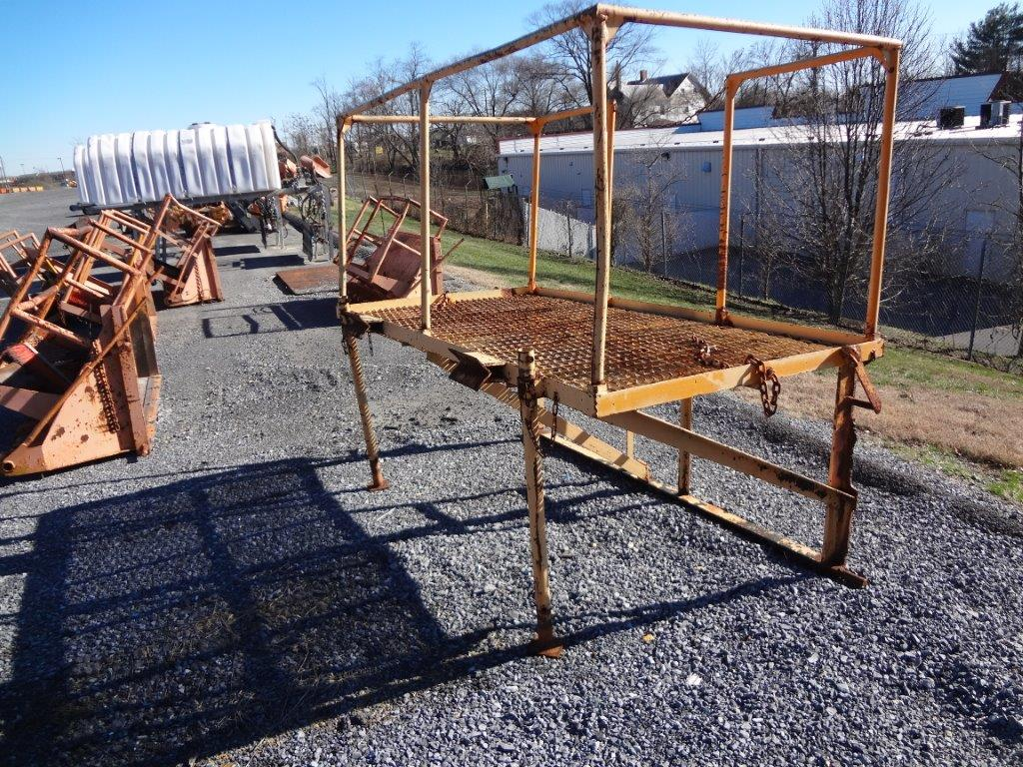

Slide 8
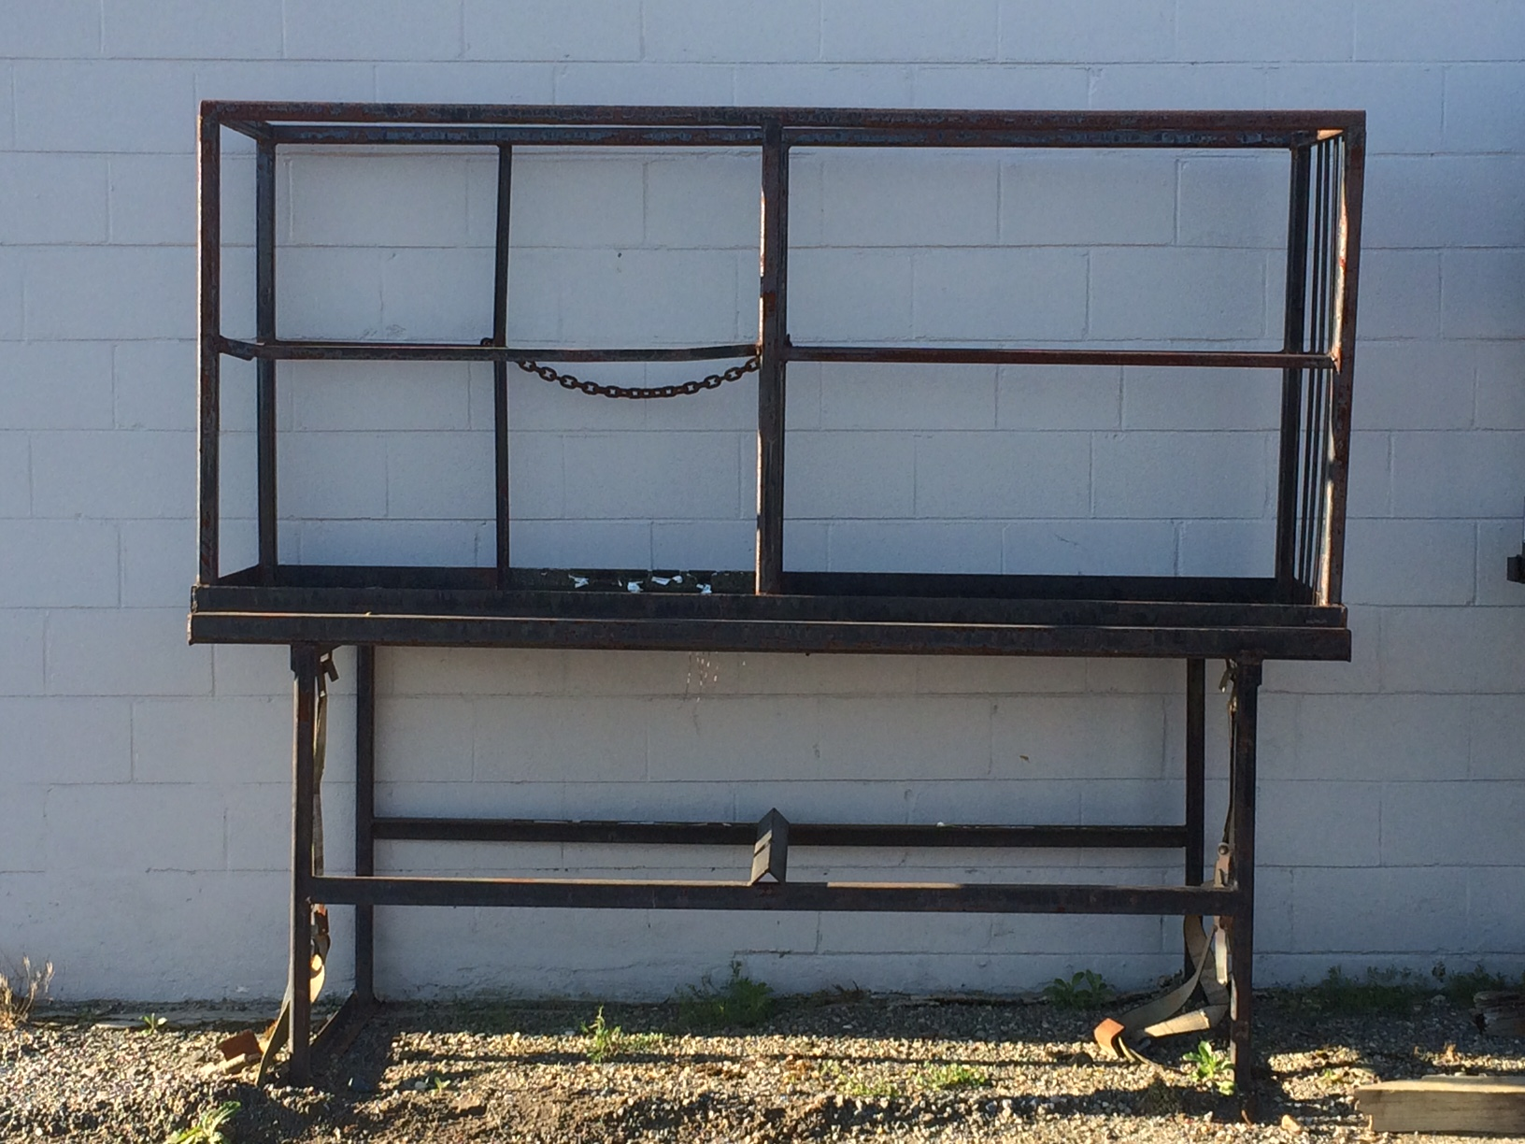

Slide 9
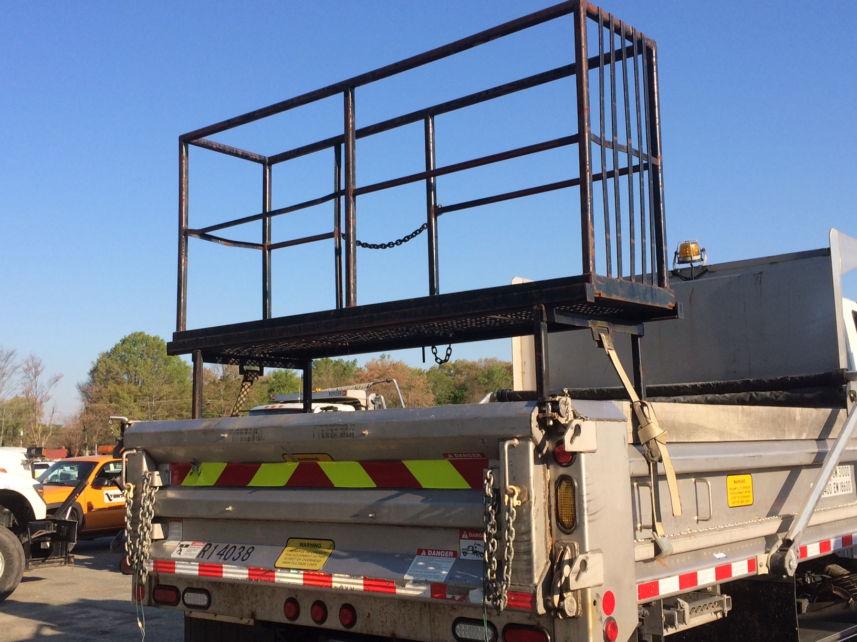

Slide 10
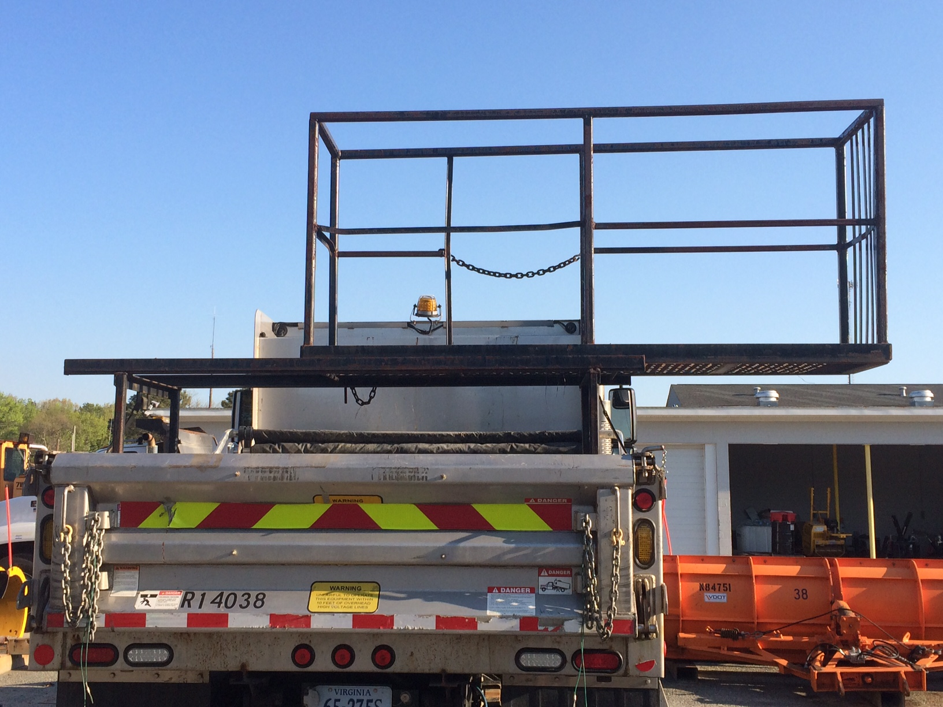

Slide 11
TREE TRIMMER PLATFORM
After 25 years of service these racks were aging and becoming scarce.
As of last year, only a few of the original racks remained in the district.
Remember, these were a product of VDOT ingenuity and were not available commercially.

Slide 12
TREE TRIMMER PLATFORM
How did we get where we are
with the platform
The Superintendent Committee requested the agency to look at the feasibility of building new racks.
The District Administrator and Maintenance Division Administrator agreed to support assessment of the issue.

Slide 13
TREE TRIMMER PLATFORM
It was confirmed that they are not available commercially, looked into possible Safety issues, and developed clear scope for the Trimmer Platform.
We (VDOT) developed the specifications for fabrication of the platform and the training materials for its use. Along with the Maintenance Division, had it reviewed by VOSH and initiated the procurement effort.

Slide 14
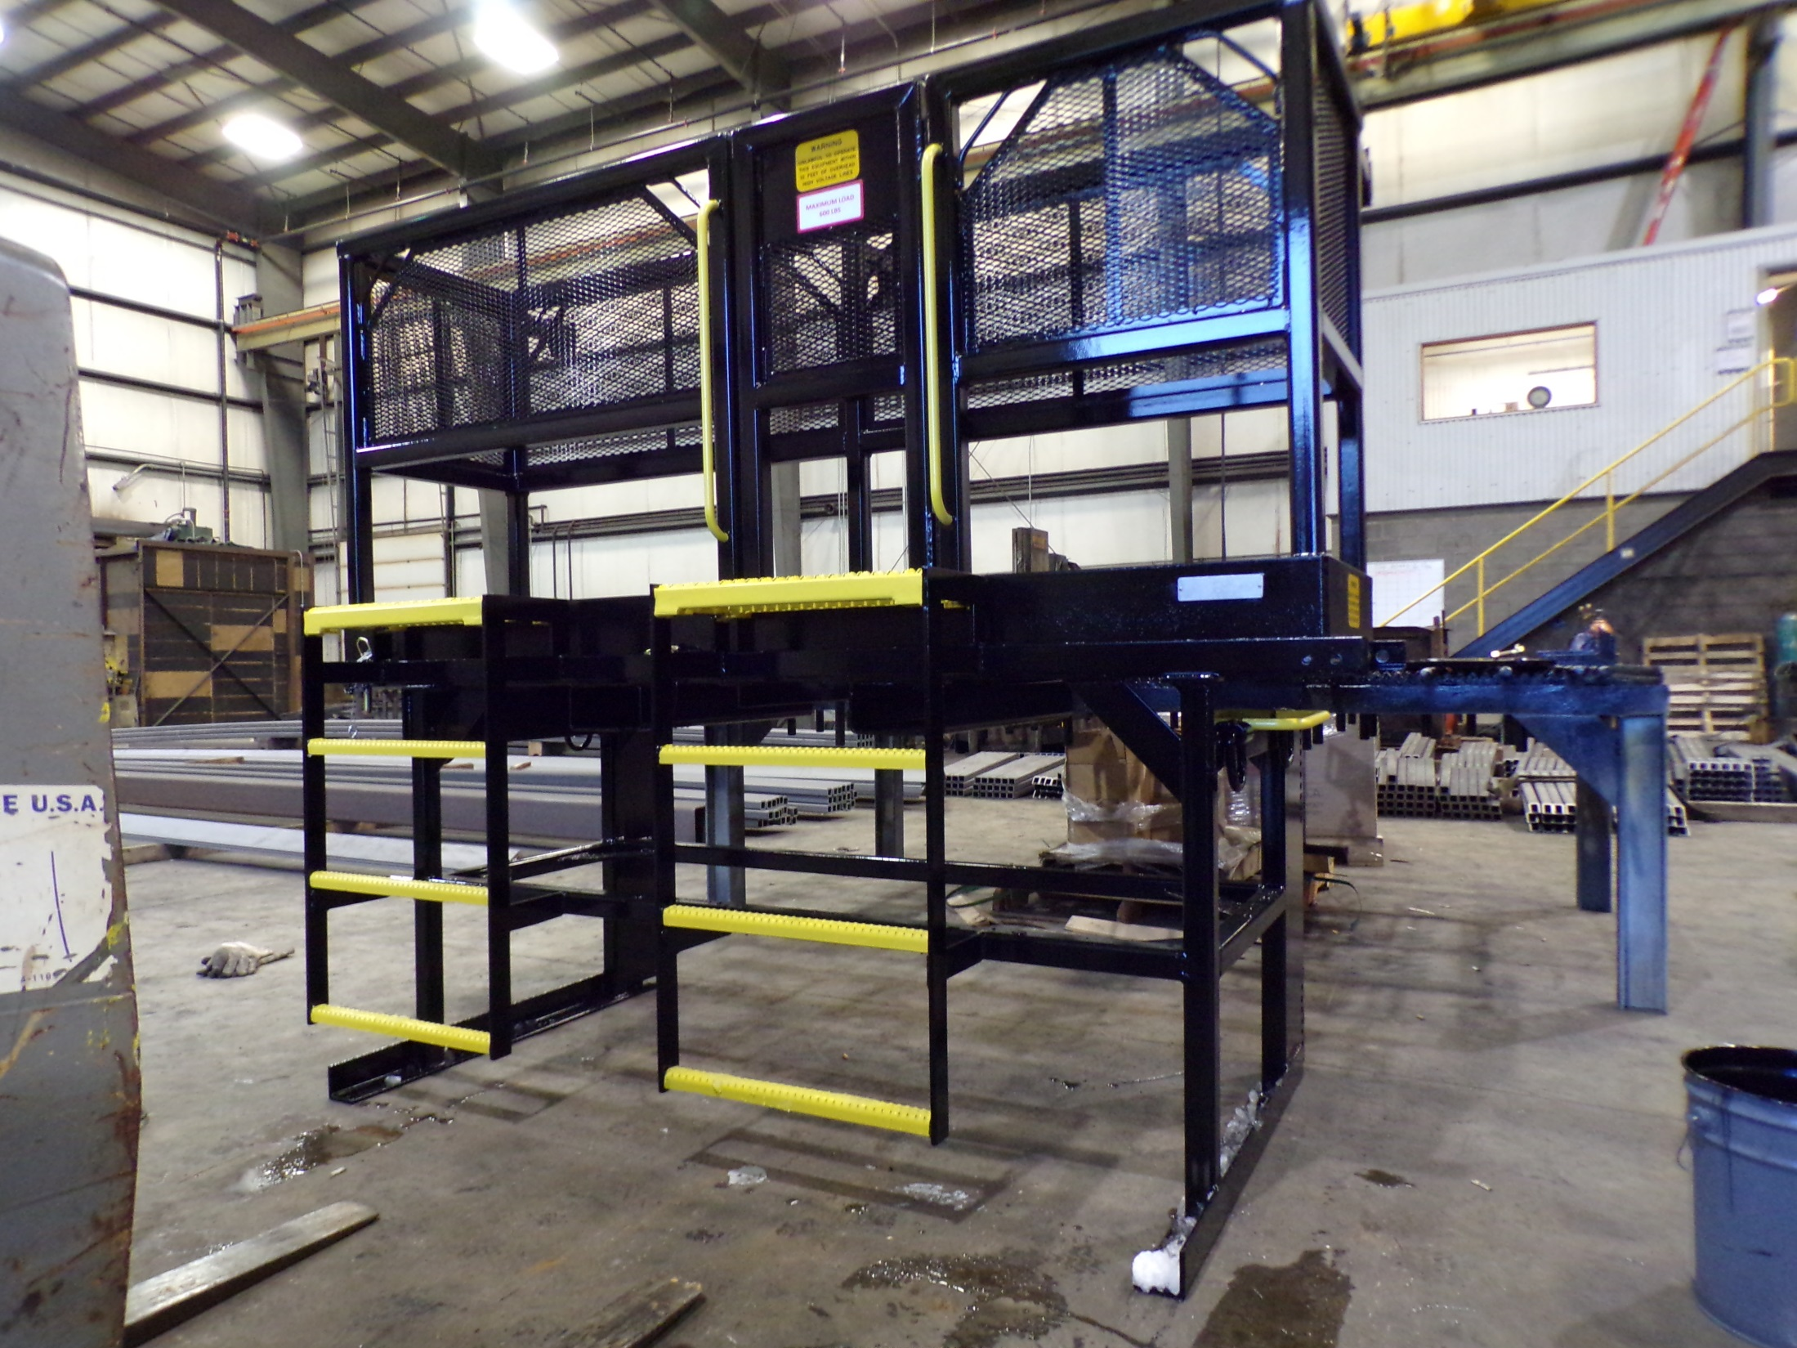
Tree Trimmer Platform
New/Improved
Tree Platform

Slide 15
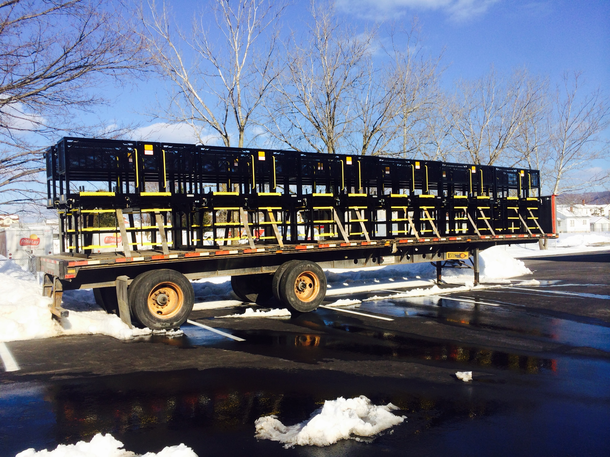
Tree Trimmer Platform
Ready for Delivery

Slide 16
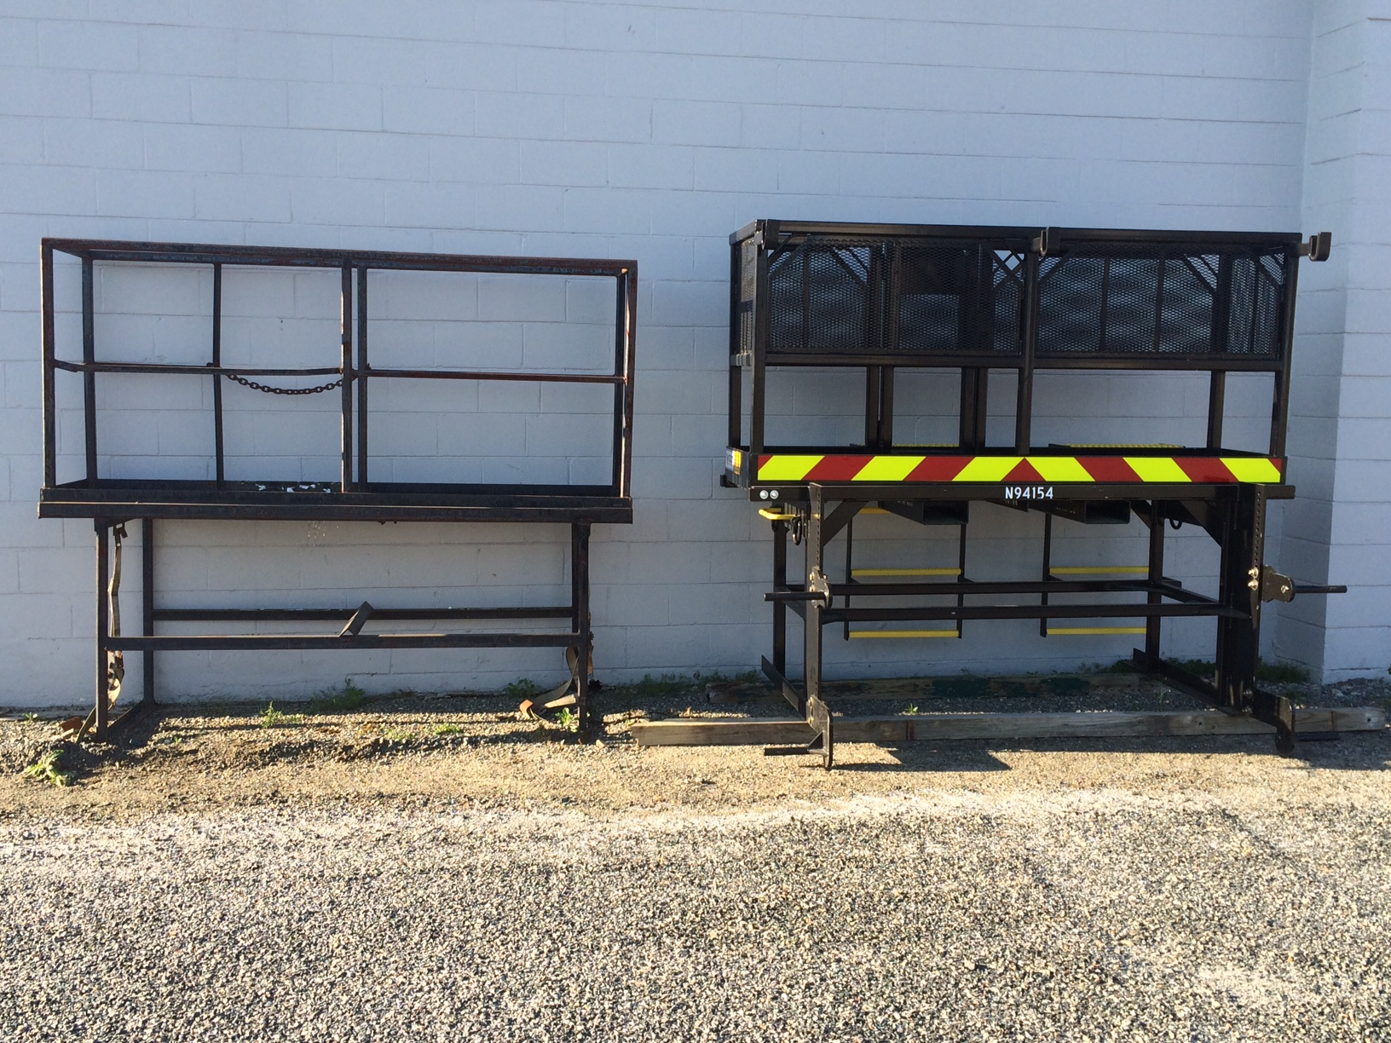
Before
After

Slide 17
